Slide 1

Capstone Project Report On “Travel Approval App”
BY:
Name: KOTA NAVANESH
Batch: WIP-SF-13
LMS Id: MGSA_518
Notes:
Introduce all the leaders

Slide 2
Contents
WHAT IS SALESFORCE ?
INTRODUCTION OF TRAVEL APPROVAL APP
MODULE 1
MODULE 2
MODULE 3
CONCLUSION

Slide 3
WHAT IS SALESFORCE ?
CRM
Salesforce Clouds
Salesforce Platform

Slide 4



What is a Customer Relationship Management (CRM) System?
“Salesforce CRM is a cloud-based customer relationship management (CRM) platform designed to improve their sales process by automate their sales, marketing and customer service process.”
Improves customer relationship management
Creates a 360 view of the customer and their interactions with the business
Organizes the information
Gives a complete record of individuals and companies
Records customer contact information
ex. Email, telephone, website, social media profile

Slide 5
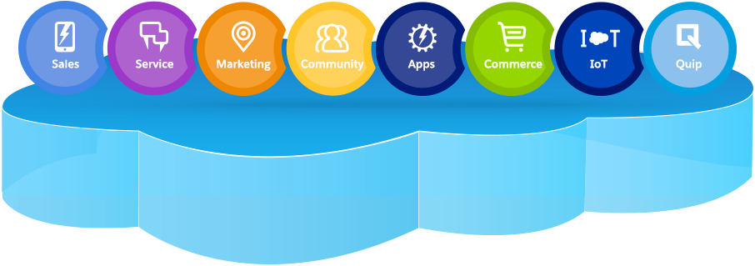
Salesforce Clouds

Slide 6
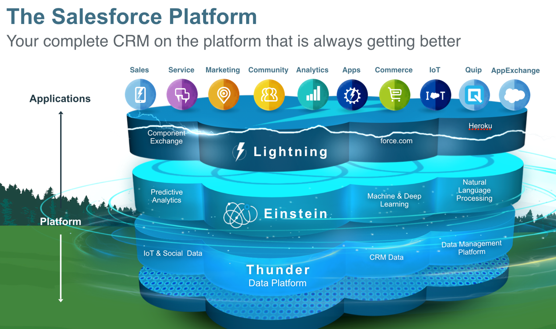

Slide 7
Travel Approval App

Slide 8
INTRODUCTION OF TRAVEL APPROVAL APP
The Salesforce Travel Approval App is a web-based application designed to streamline the travel approval process for employees
This app is built on the Salesforce platform, which provides a robust and customizable framework for managing travel requests
This project involves several components, including a custom object to track travel requests, a custom approval process, etc…
The travel approval app is the efficient way for employees to request and manage travel expenses
Notes:
Key Messages
The global impact of Salesforce is bigger than our technology
With our partners and customers we are creating millions of jobs around the world
Talk Track This effect, is what IDC has coined, “the Salesforce Economy”. By 2022, this ecosystem of customers, partners and Trailblazers will create 3.3M jobs, drive $859B in GDP impact, and deliver new employment opportunities at scale. Transition Let’s take a look at the types of jobs and roles.
Additional Talking Points and Resources
React positively to the economic and job outlook -- use the phrases “Salesforce Economy” whenever possible
Look to the future, if applicable. Discuss how the Salesforce ecosystem is poised to lead the way in new areas like IoT, analytics, AI and more. (HINT: We love to hear about Lightning).
Touch on the new job and revenue numbers and how together – Salesforce, our partners and customers, will reach this milestone.

Slide 9
MODULE 1
This project module focuses on the non-coding approach to modifying the user interface and customize an app that tracks company travel.
Create
Custom App
Objects
Fields & Relationships
Customize the App using declarative tools

Slide 10
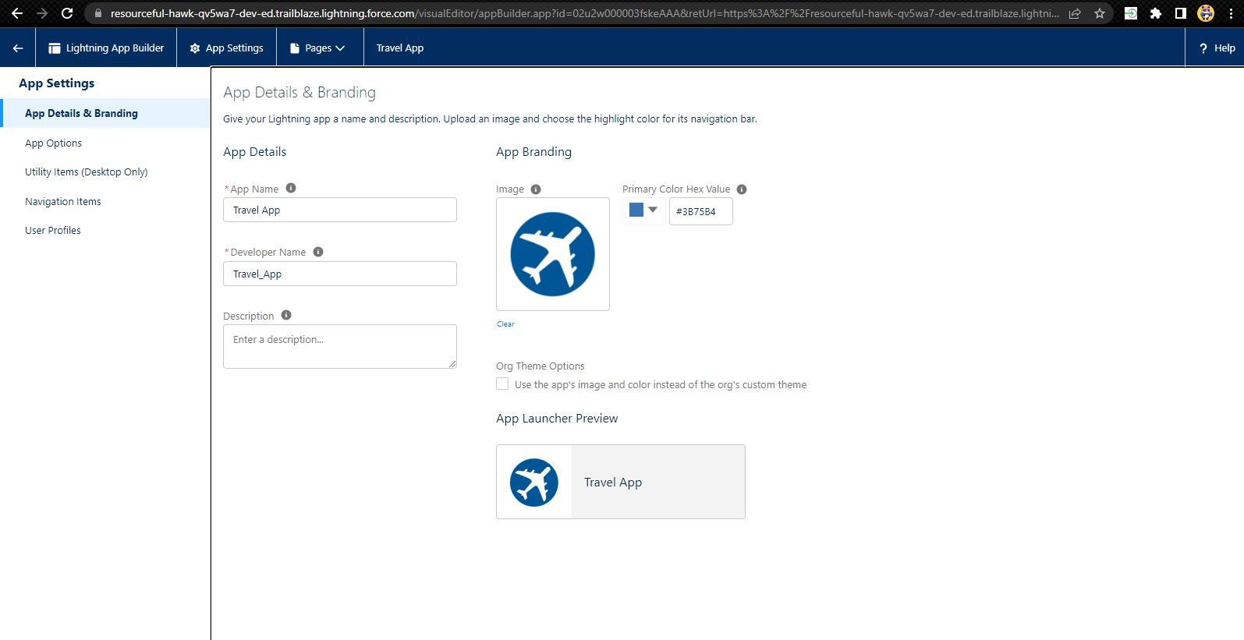
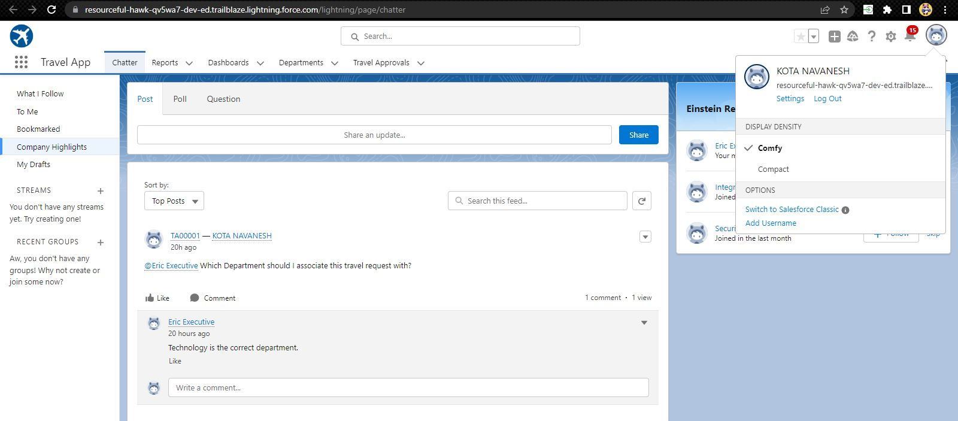
Creating Lightning Travel App

Slide 11
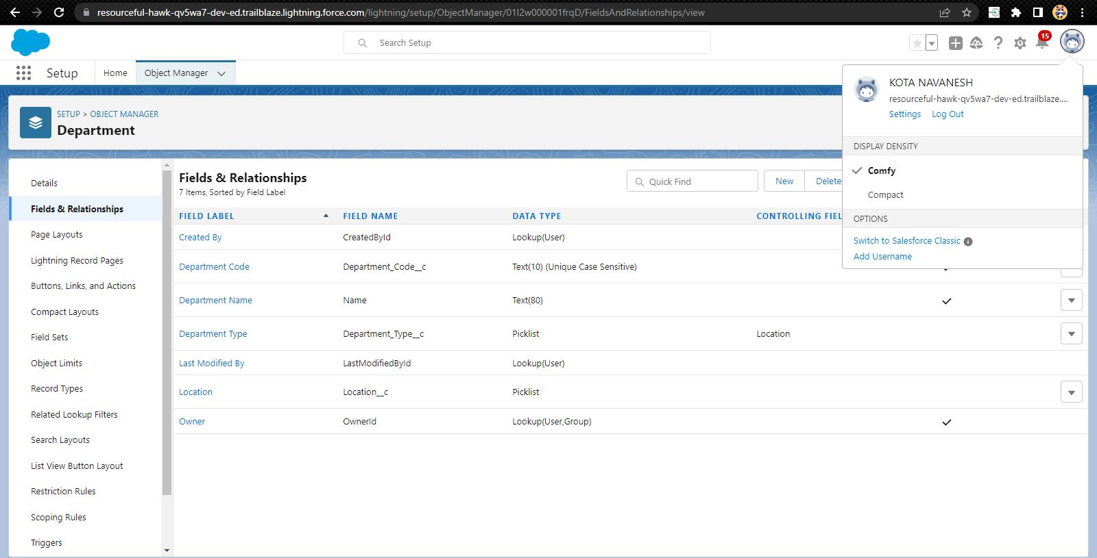
Custom object Department and Creating custom fields in Department object

Slide 12
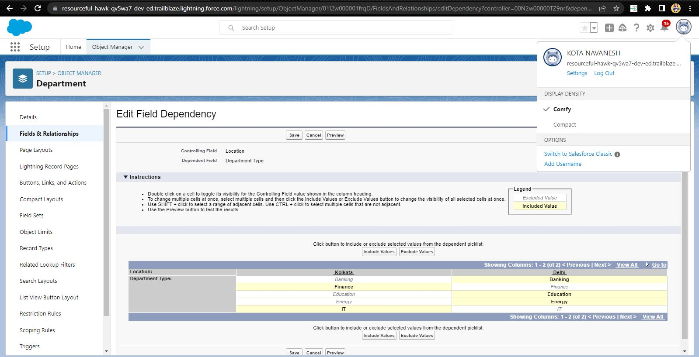
Field dependency in department object

Slide 13
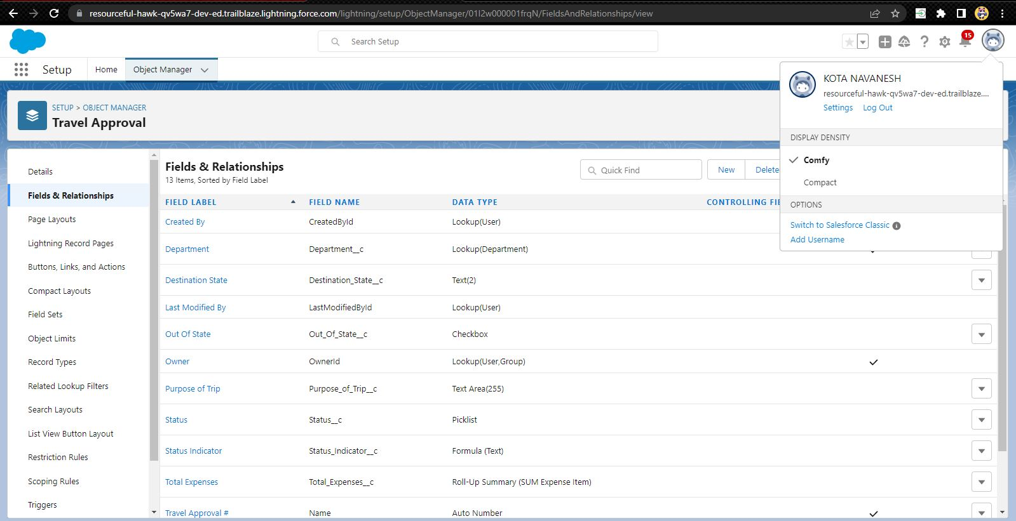
Creating Custom Object Travel Approval and Custom Fields in that Object

Slide 14
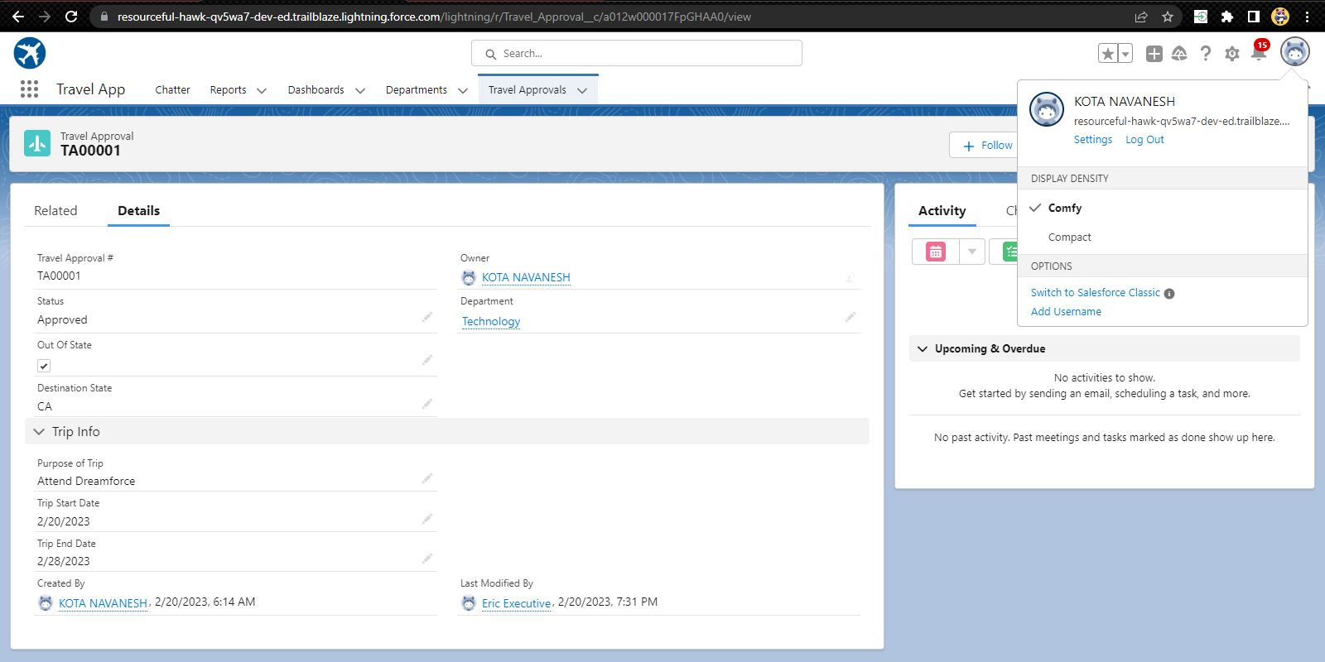
After creating travel approval object with fields, it looks as shown below

Slide 15
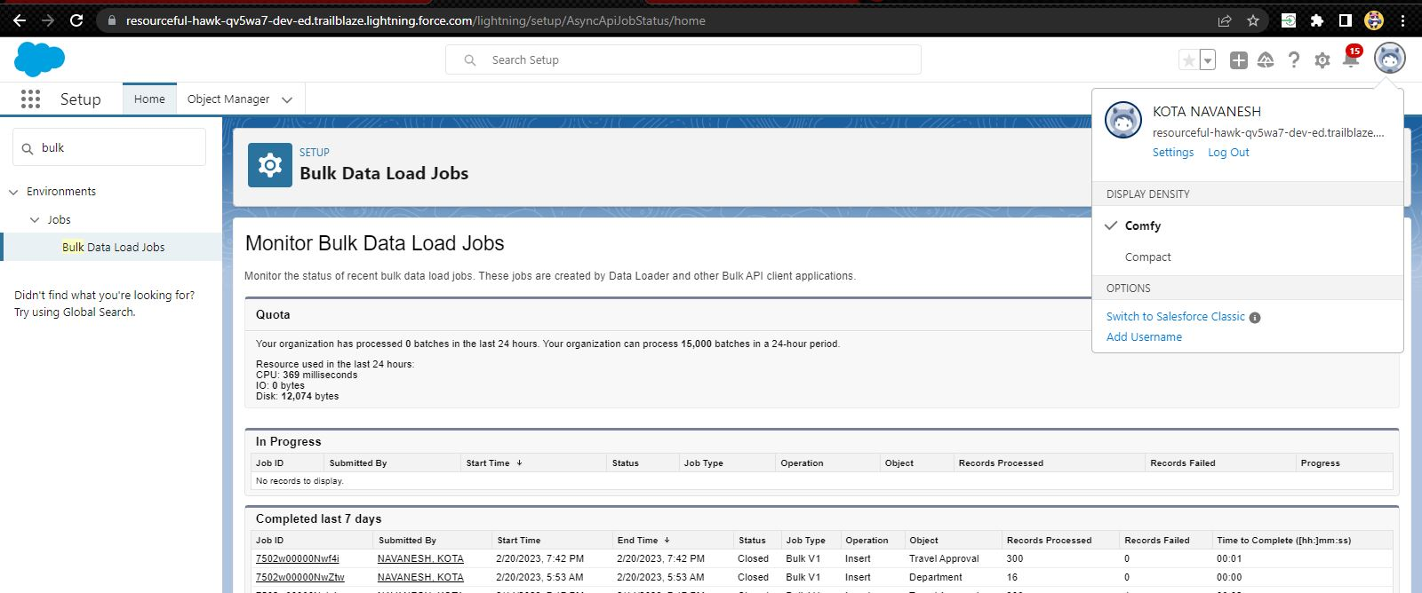
Importing Department records using data import wizard and imported record data status can viewed below in Bulk Data Load Jobs

Slide 16
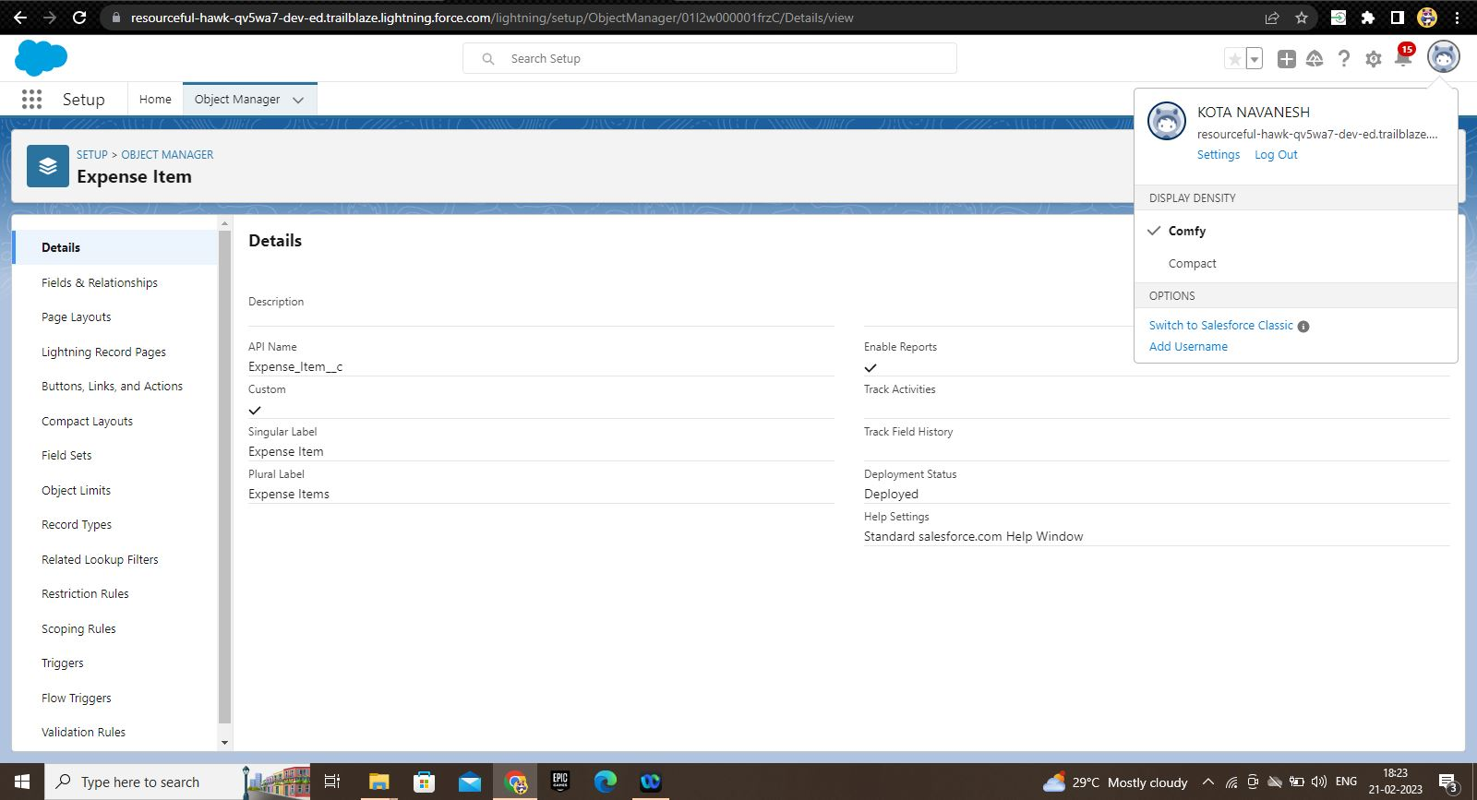
Creating Expense Item custom object and Custom fields in Expense Item object

Slide 17
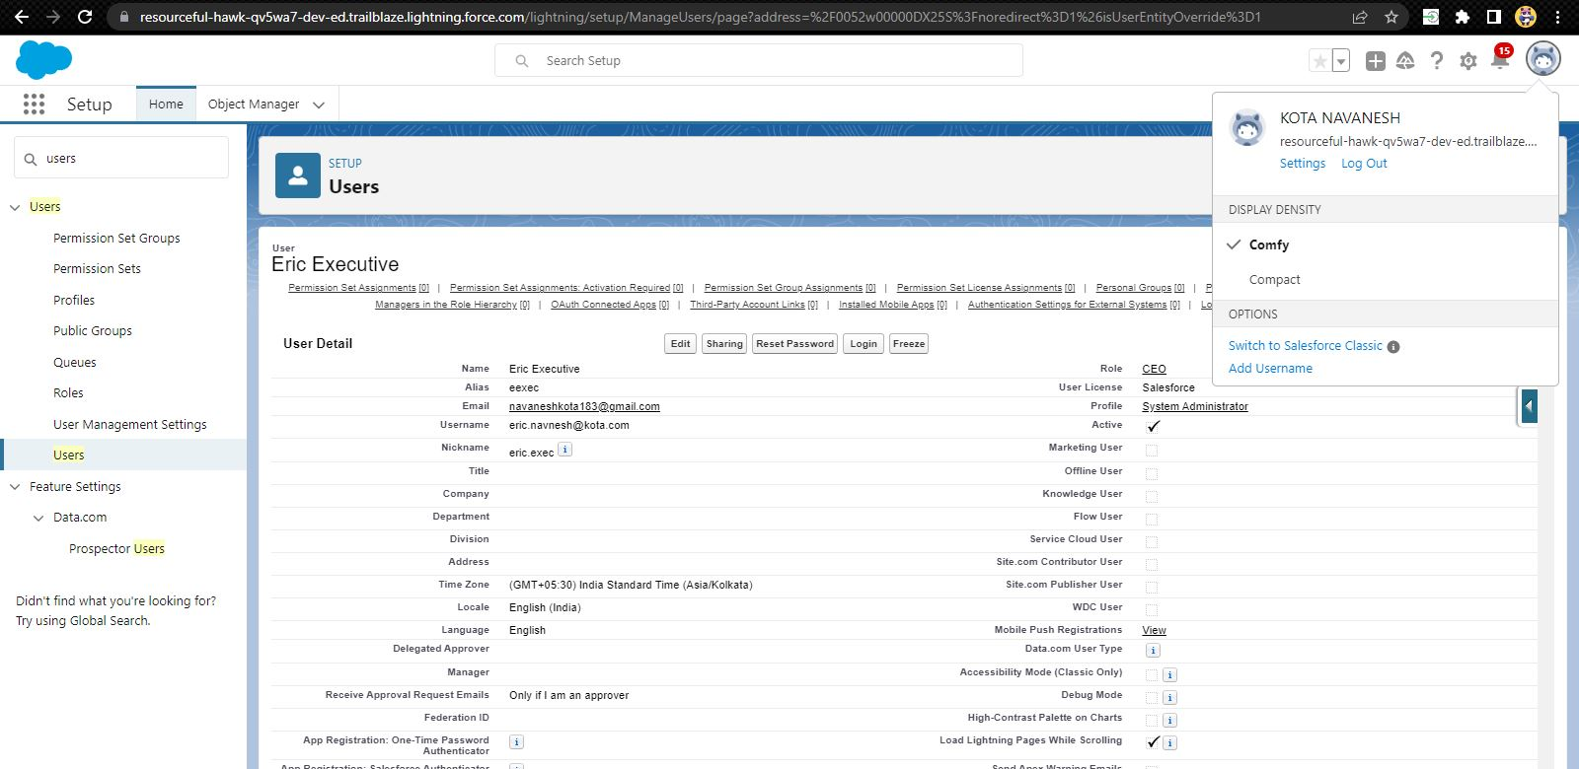
Creating User with system admin license and add that user as your manager

Slide 18
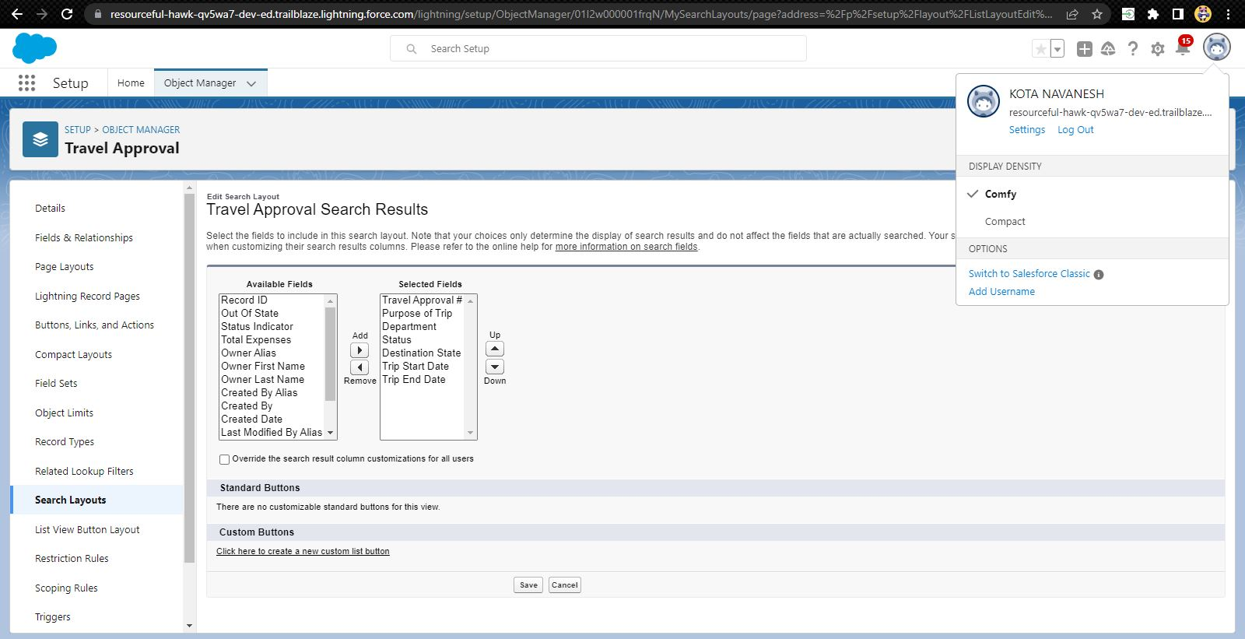
Customize the Travel Approval Default search layout

Slide 19
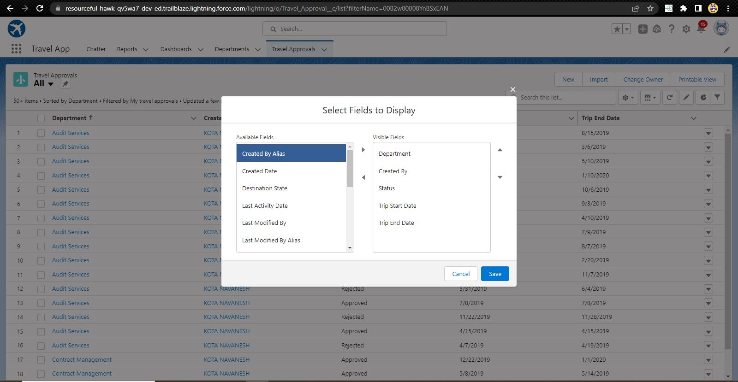
Select fields to display in the Travel Approval “All” List view

Slide 20
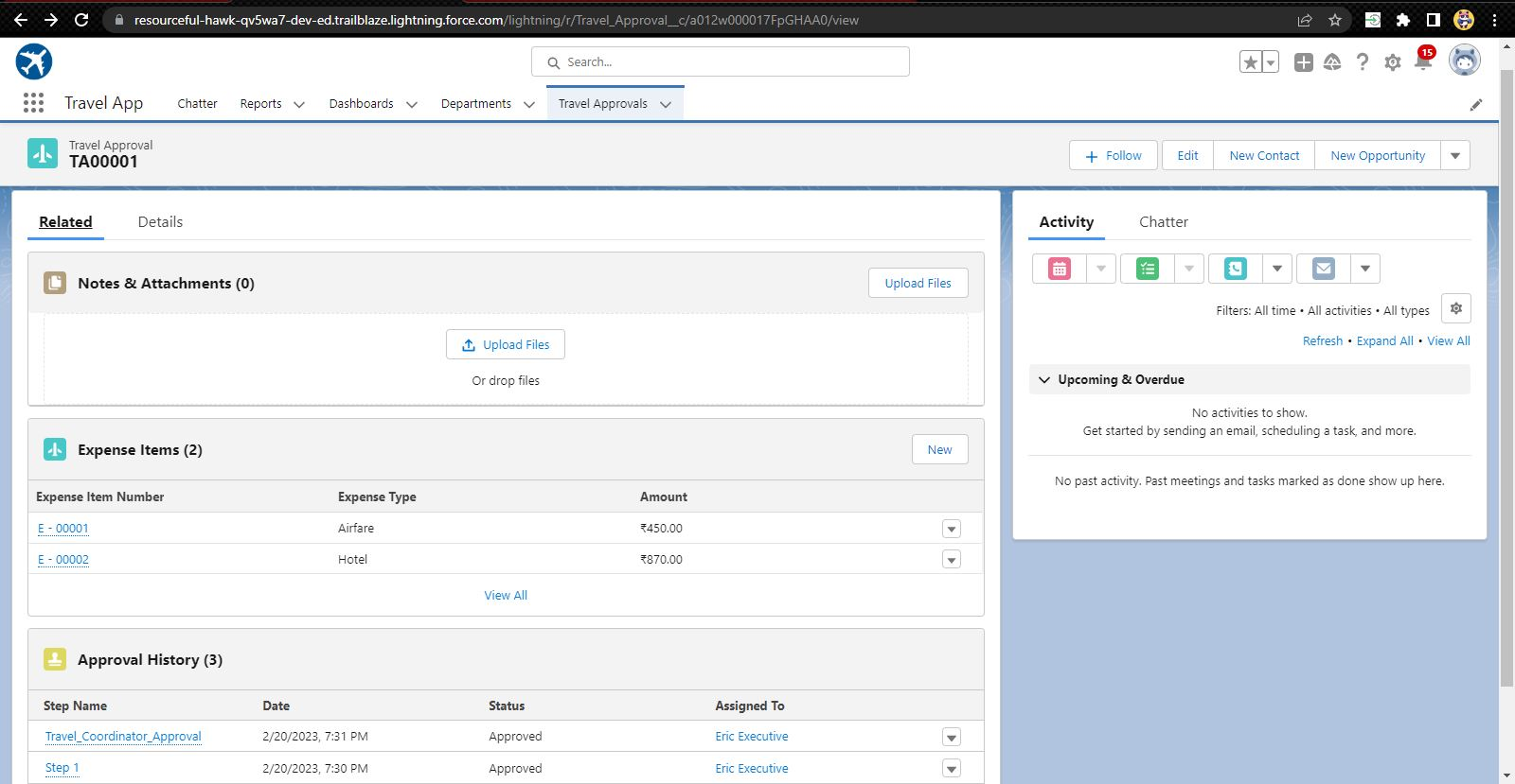
Customizing page layout

Slide 21
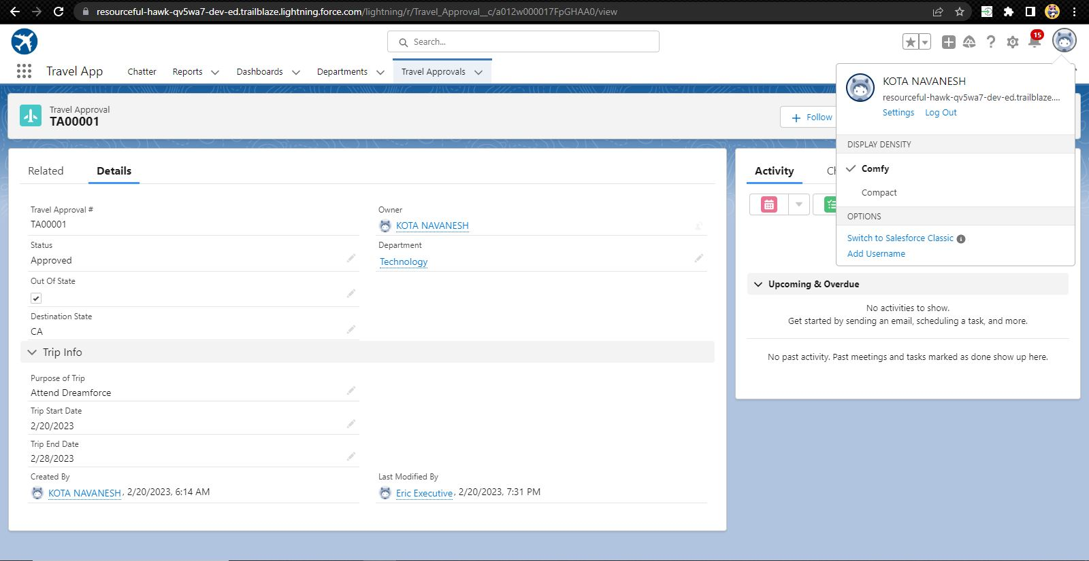
Test the app

Slide 22
MODULE 2
This project module focuses on the Automation and Analytics Tools to enhance your custom App development
Define Validation rules
Roll-up summary fields
Formulas
Flows
How you track Travel Approvals using Reports and Dashboards

Slide 23
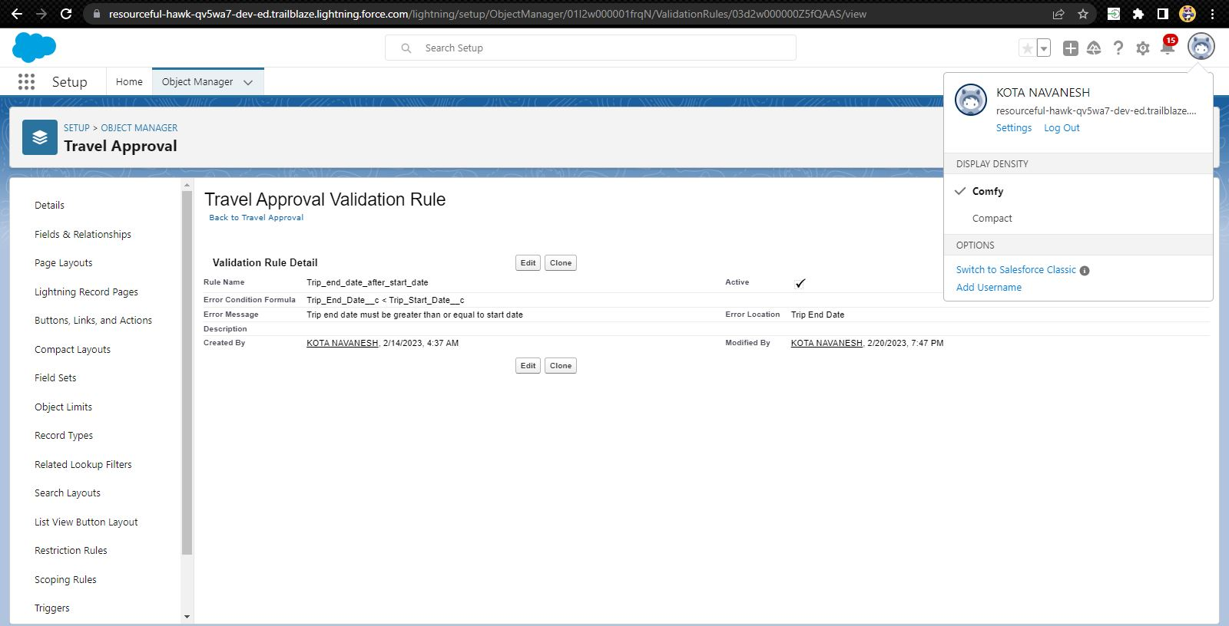
Validation Rule that trip end date always >= start date

Slide 24
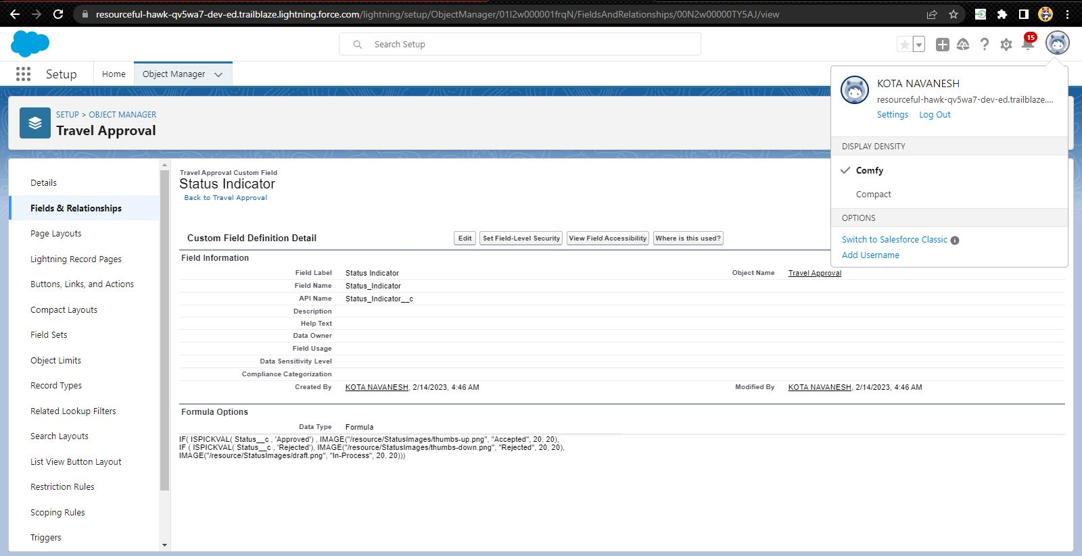
Creating Static Resource with name StatusImages

Slide 25
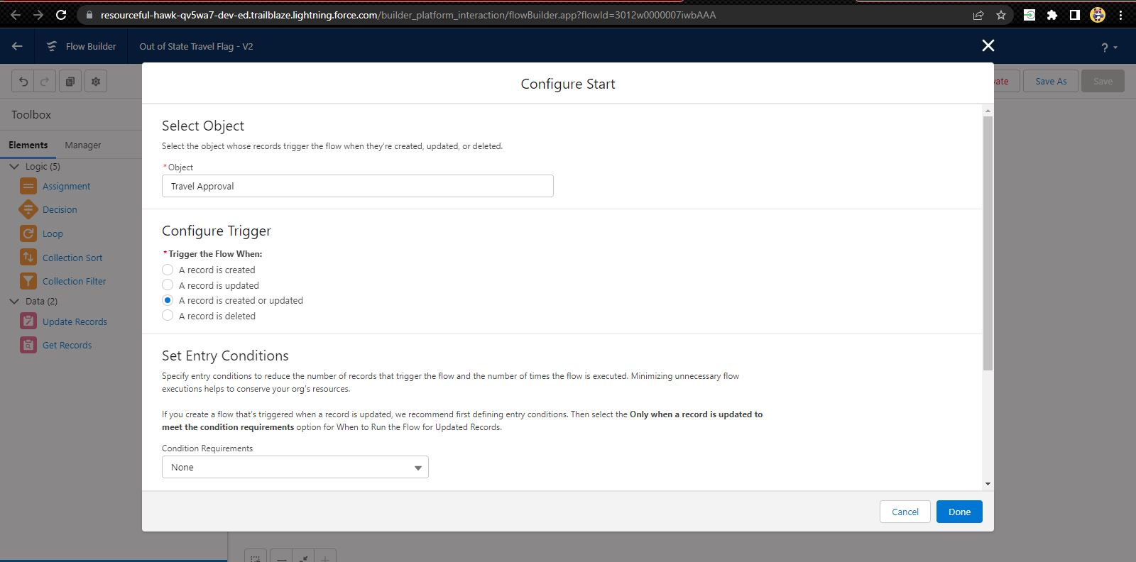
Create a Record – Triggered Flow

Slide 26
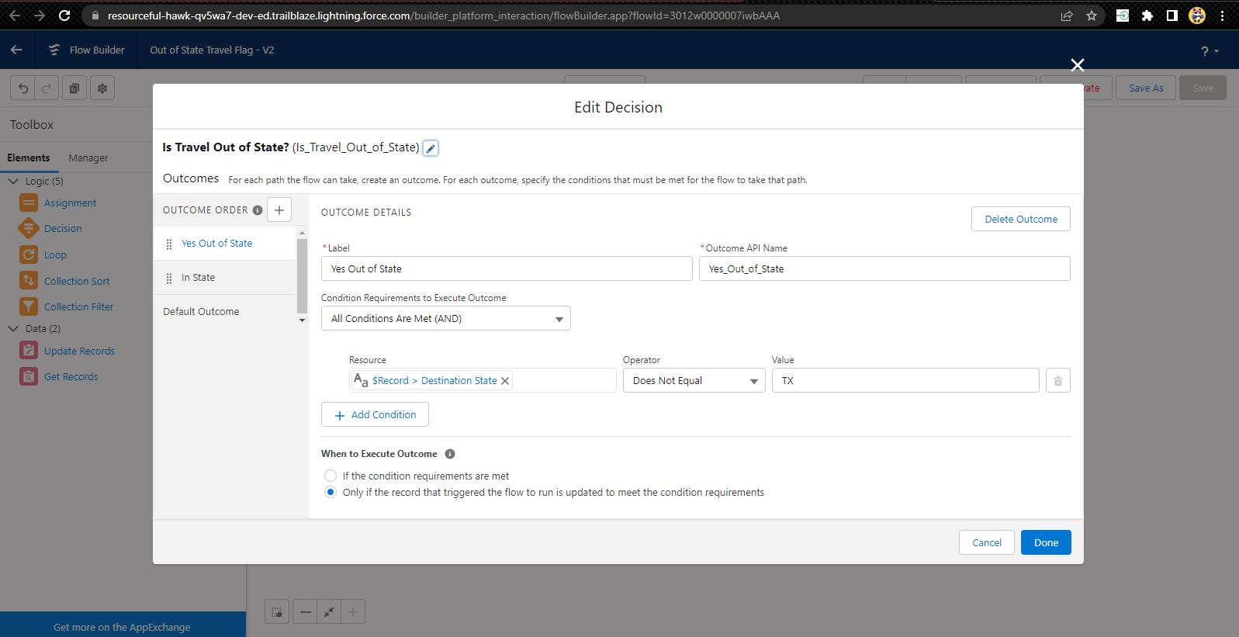
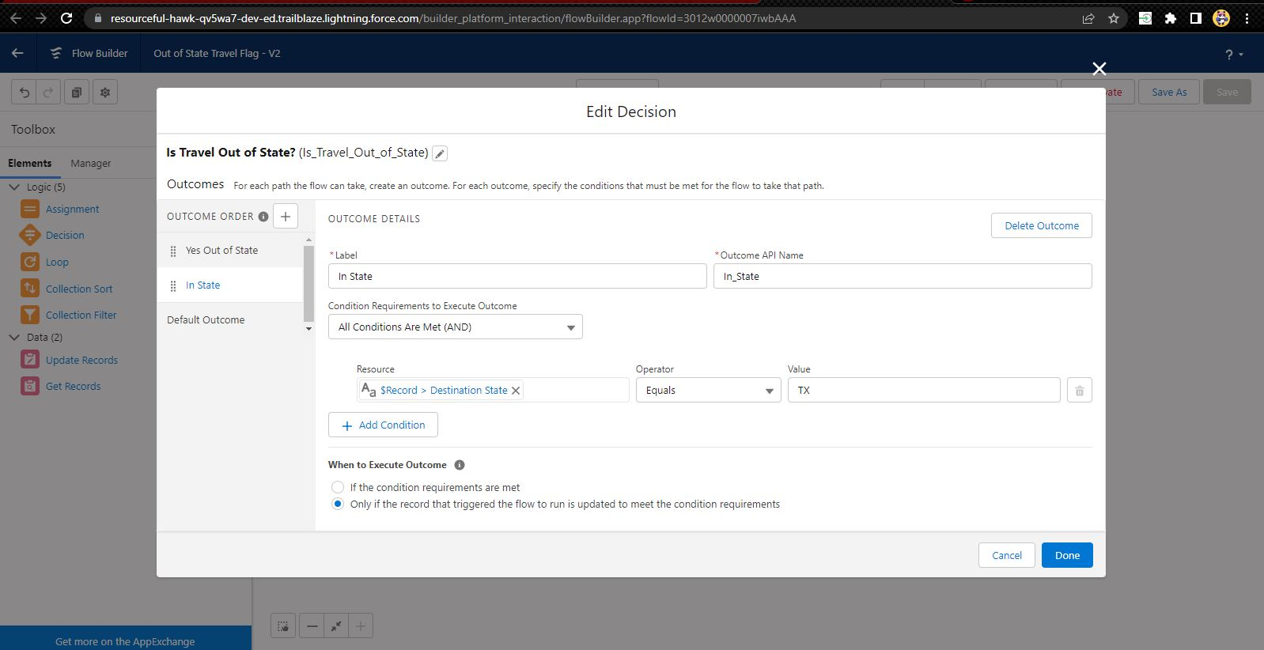
And add Decision element to flow

Slide 27
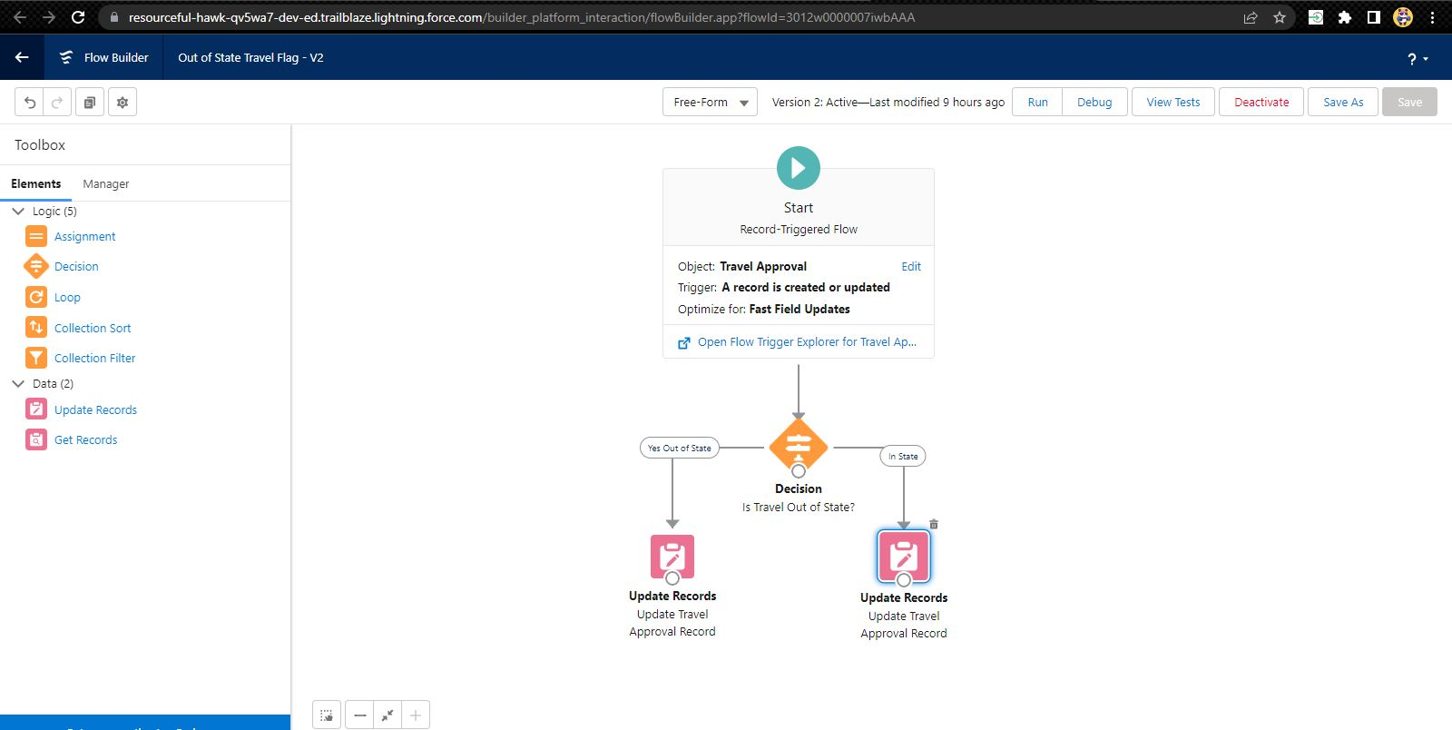
Finally, the flow looks as shown

Slide 28
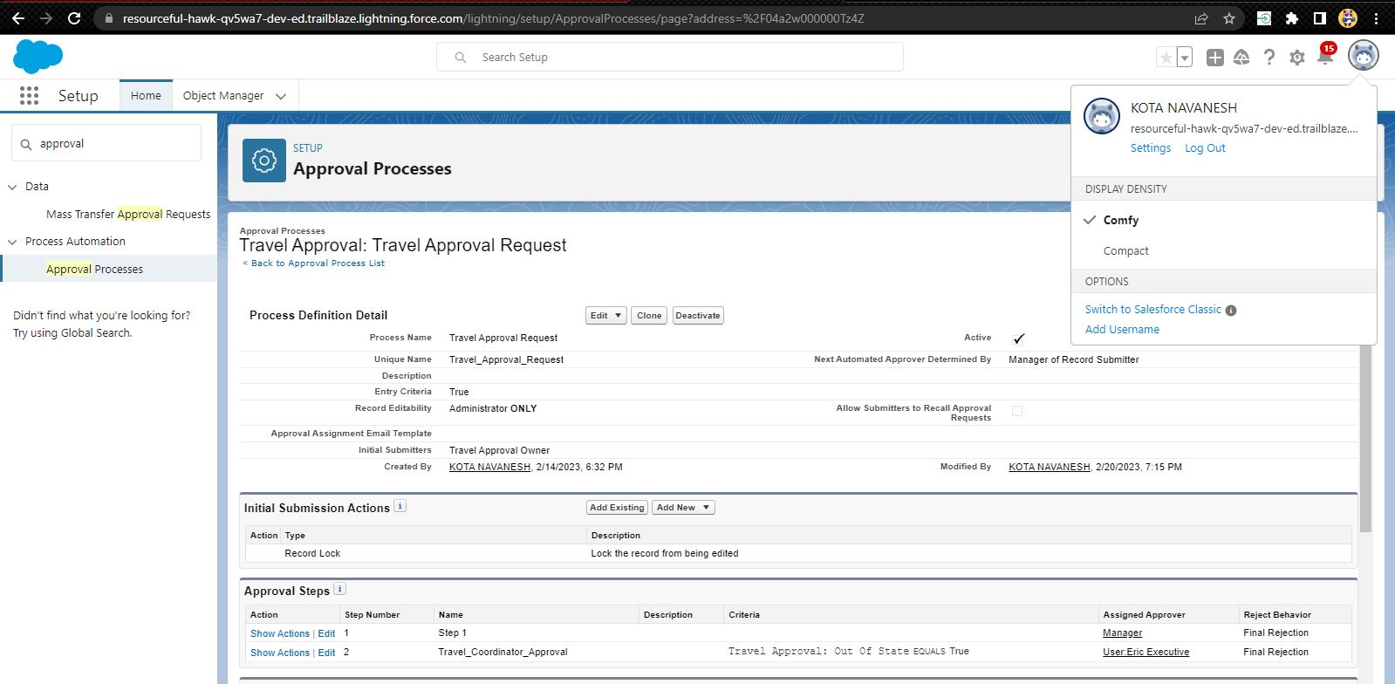
Creating an Approval Process to send travel approvals to manager or travel coordinator

Slide 29
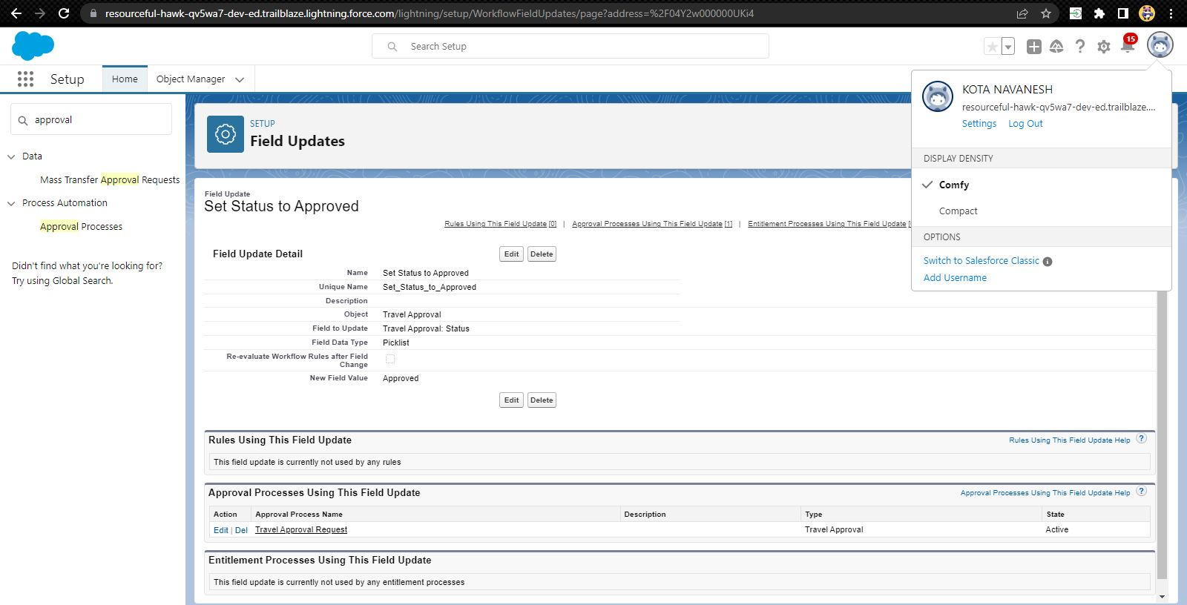

Final Approval Action and Final Rejection Action

Slide 30
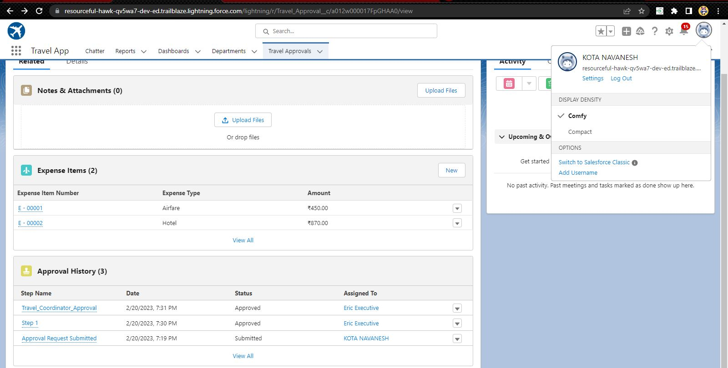
Approval History

Slide 31
Using Data import wizard to import travel approval records , later the Records imported successfully

Slide 32
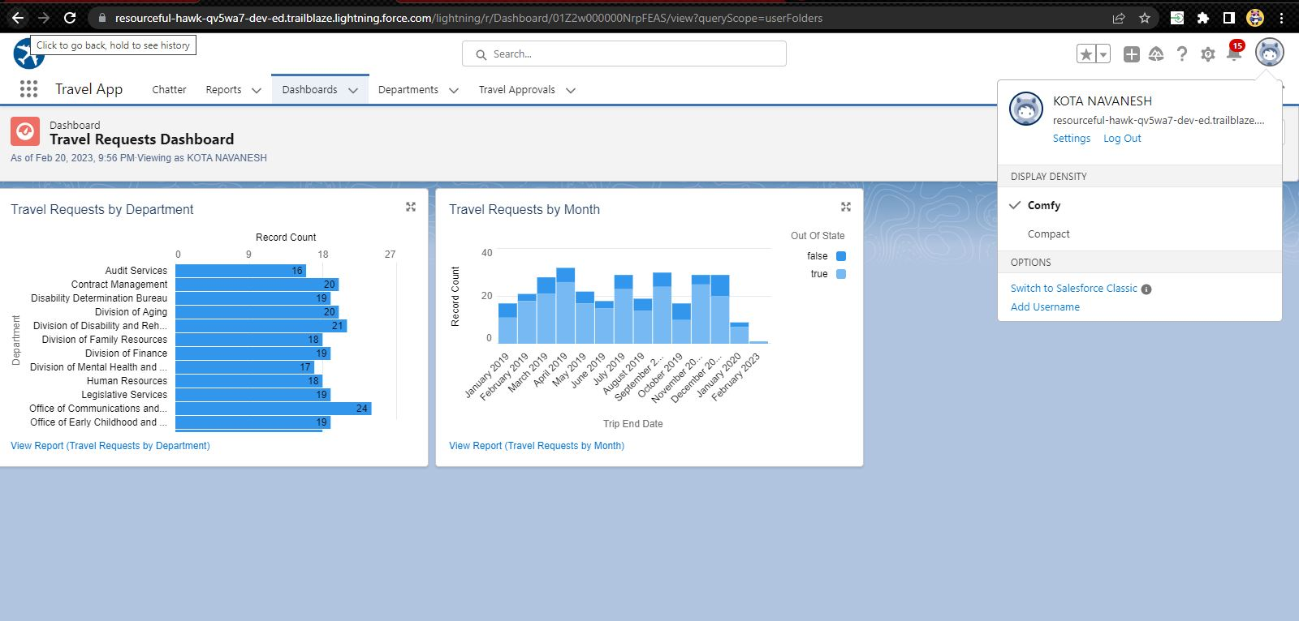
Dashboard

Slide 33
MODULE 3
This project module focuses on the coding approach to extend the functional capabilities of your custom App.

Slide 34
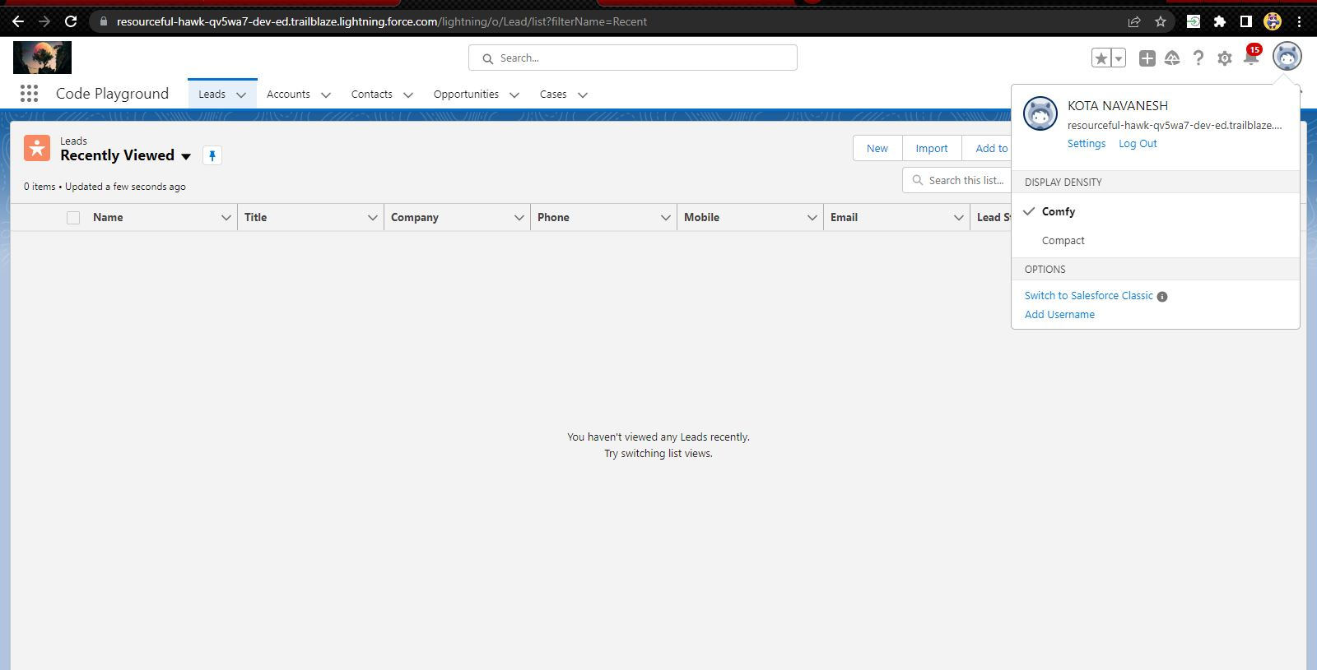
Exercise - 01 Creating Code Playground Lightning App with Lead, Account, Contact, Opportunity, Case to navigation profile as system admin.

Slide 35
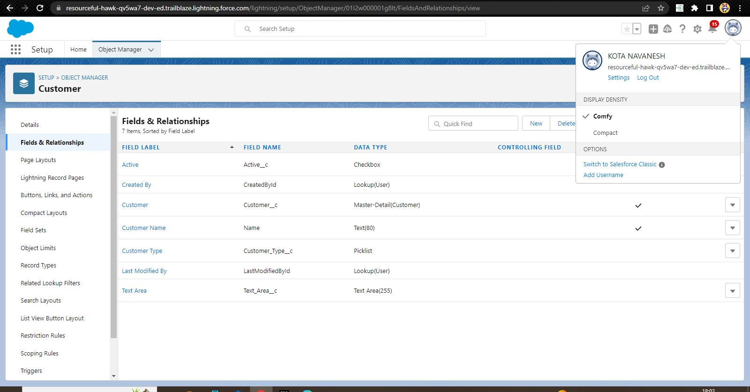
Creating custom object Customer and add related fields

Slide 36
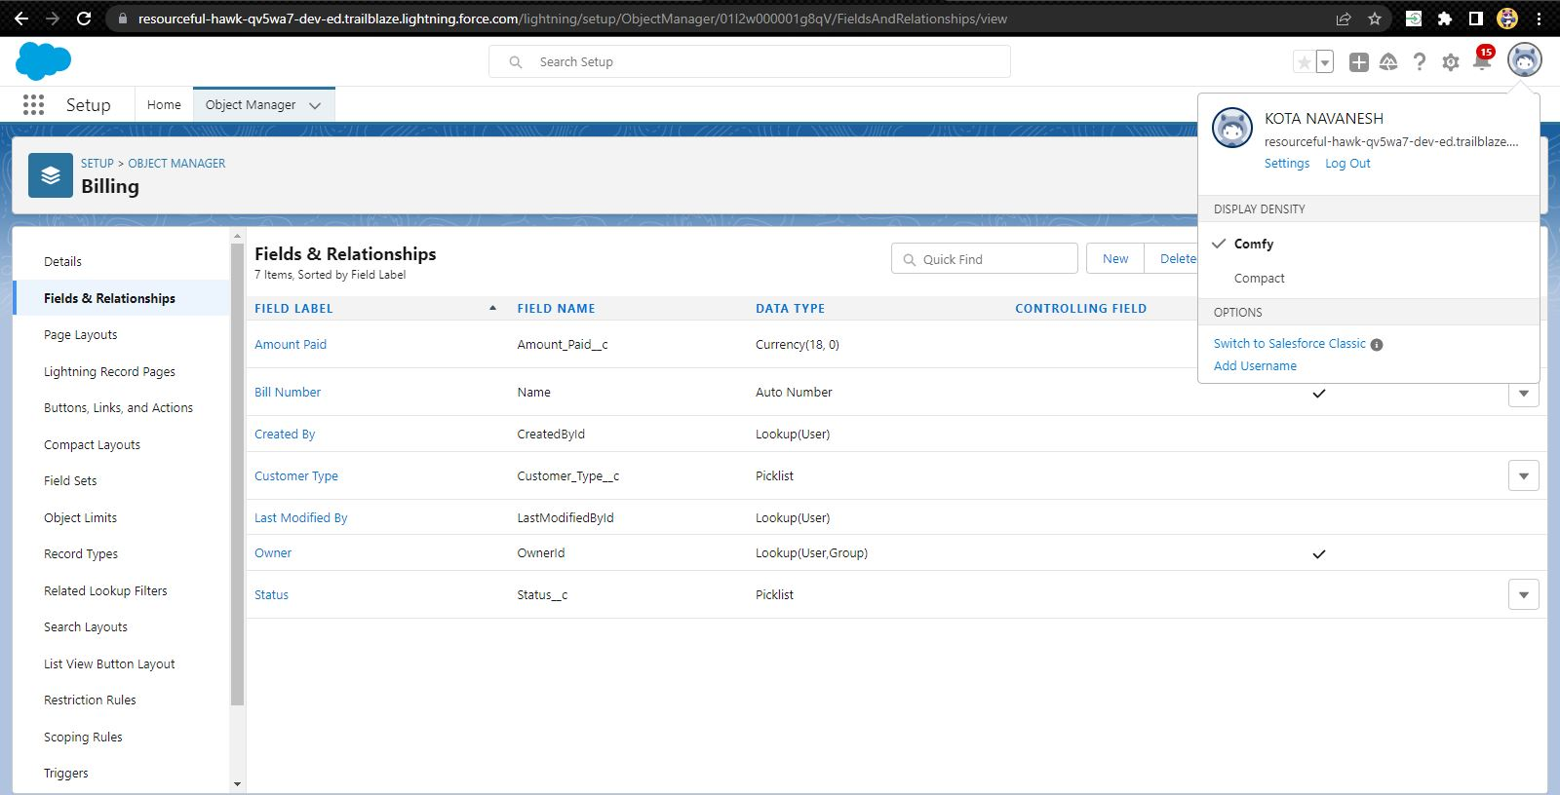
Creating custom object Billing and add related fields

Slide 37
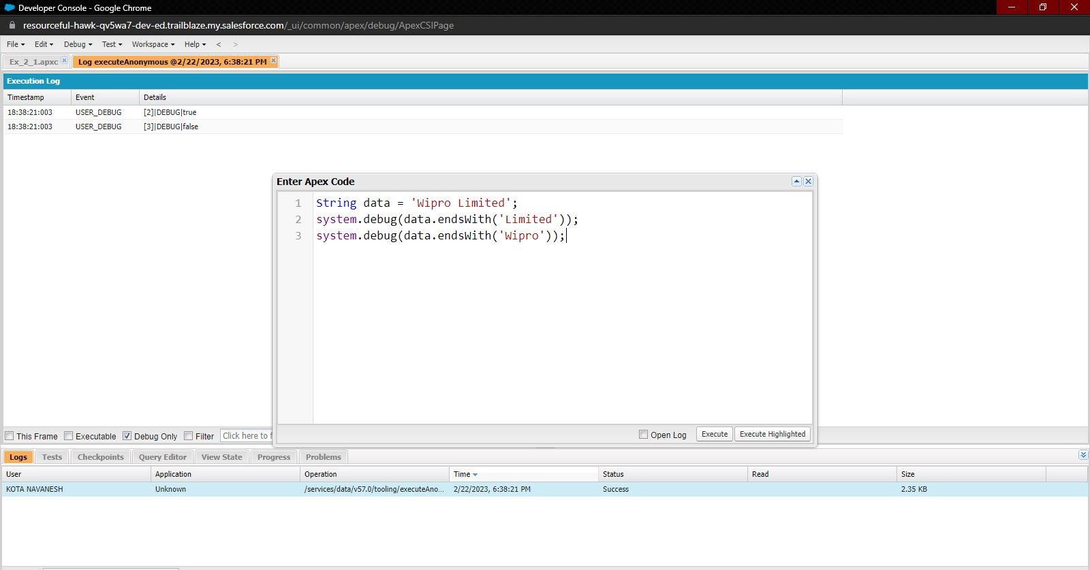
Exercise - 02 1.Define a String Variable & use string method ‘endsWith’ to display the output. By clicking oh Debug and select open Anonymous window

Slide 38
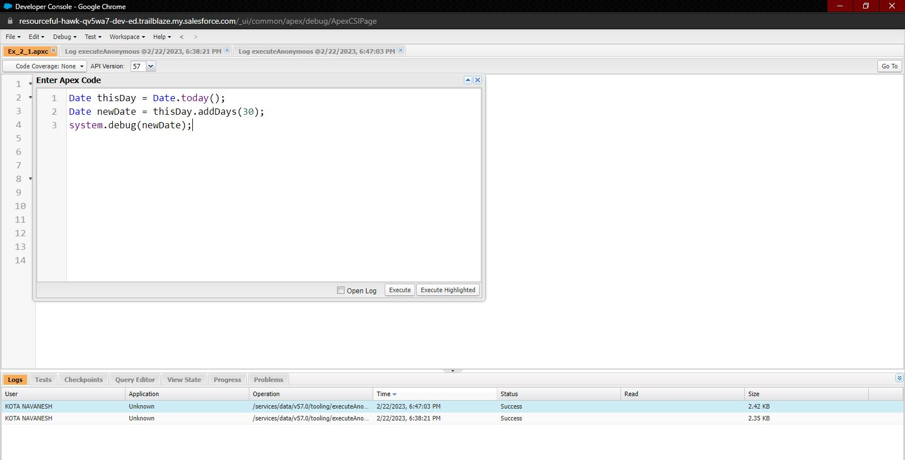
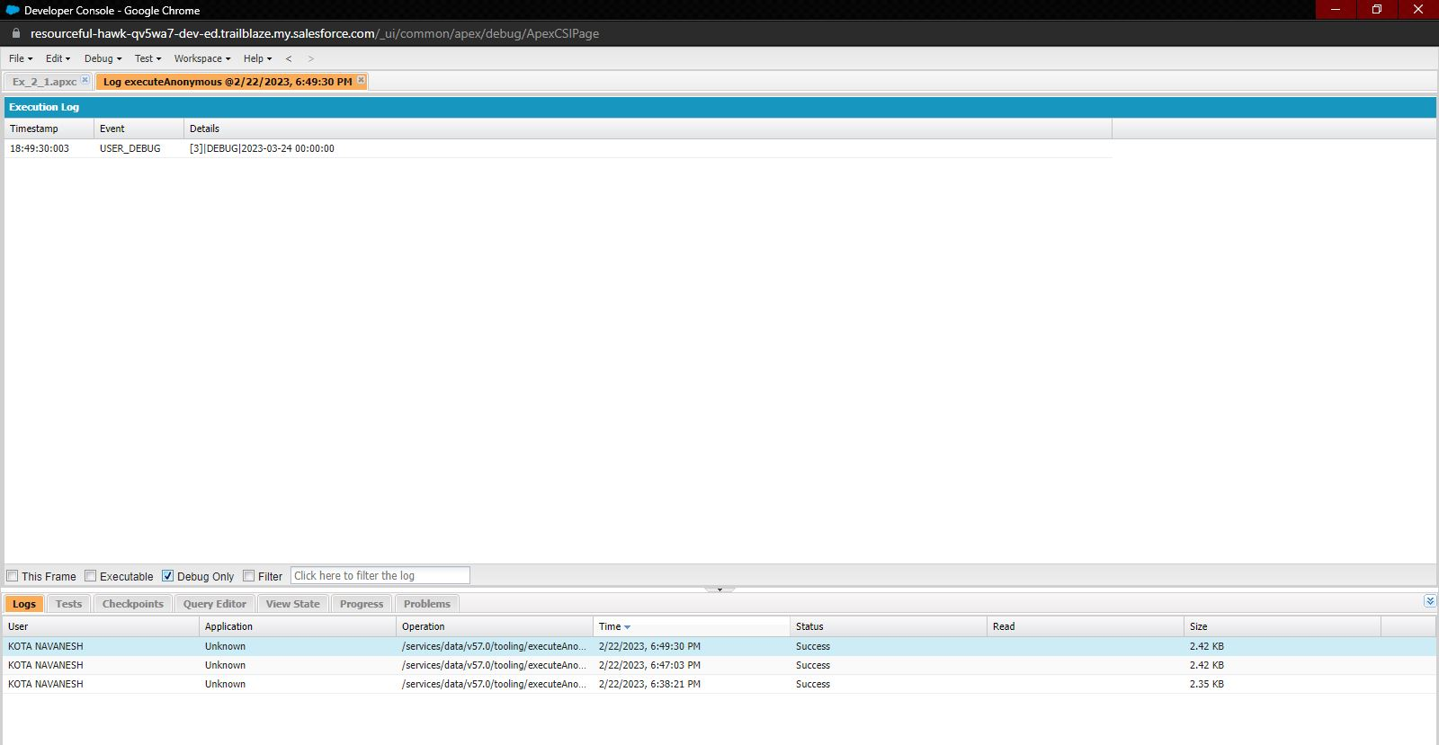
2. Define 2 Date type variables, use Date method today() & addDays(30) to display the output

Slide 39
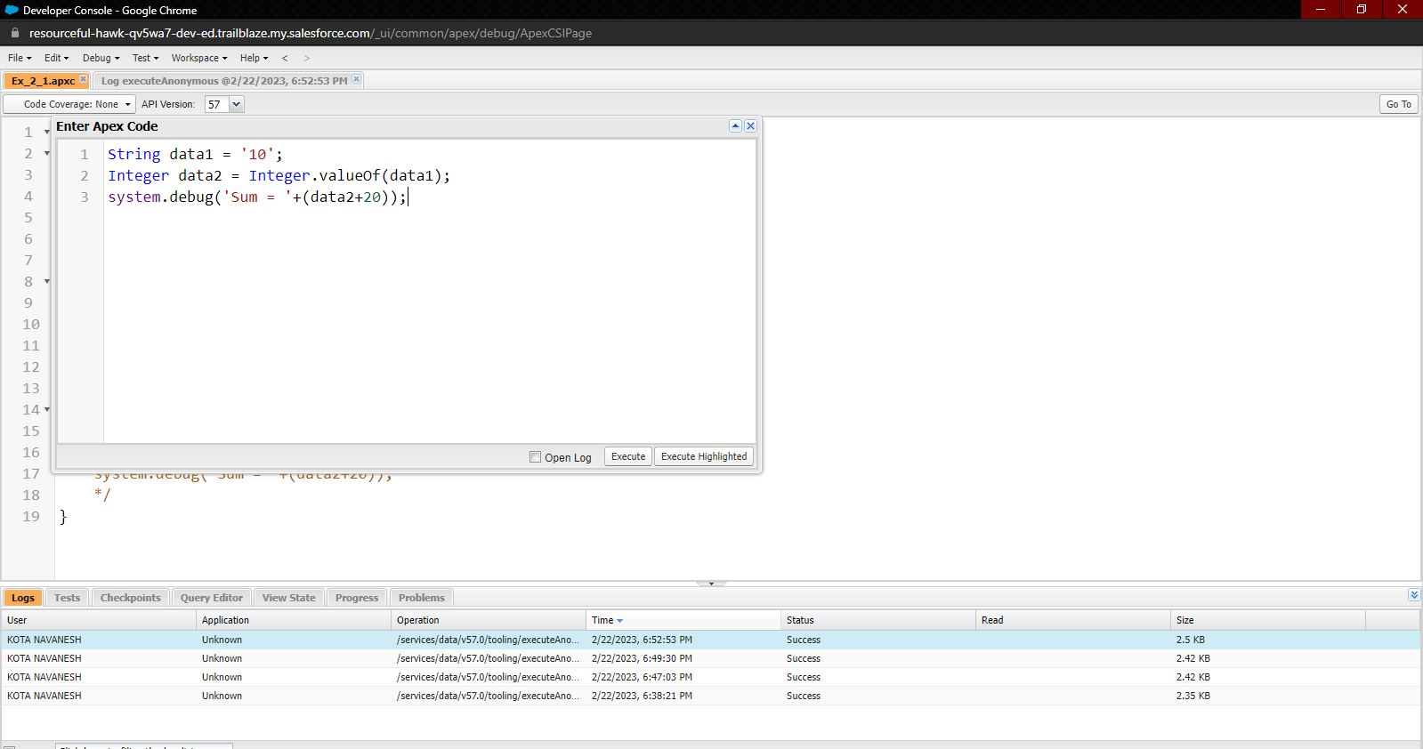
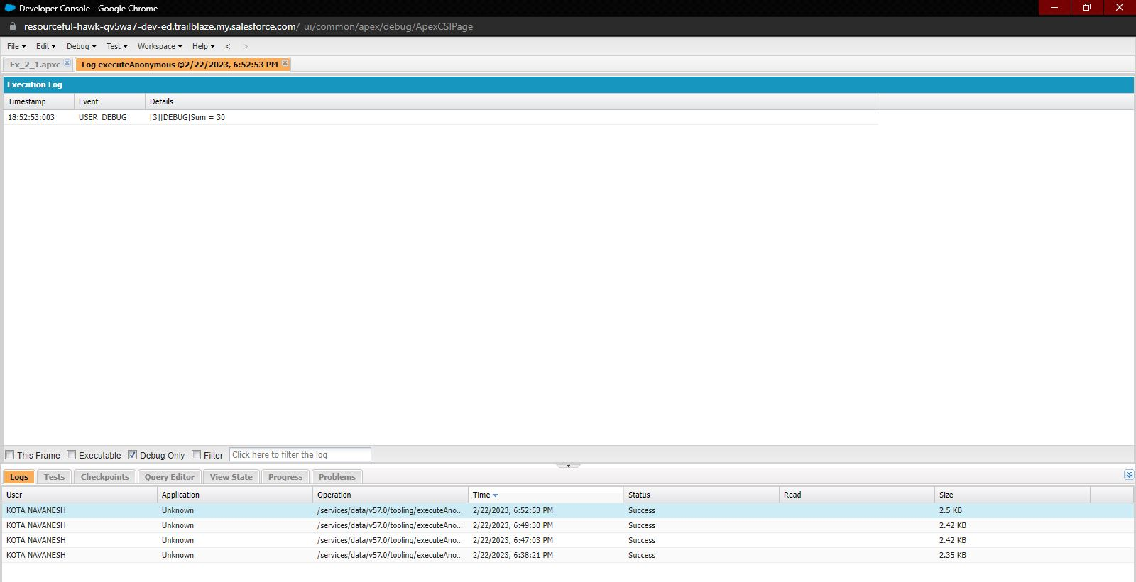
3. Display the output of an Integer variable from string ‘10’ and then add 20 to it.

Slide 40
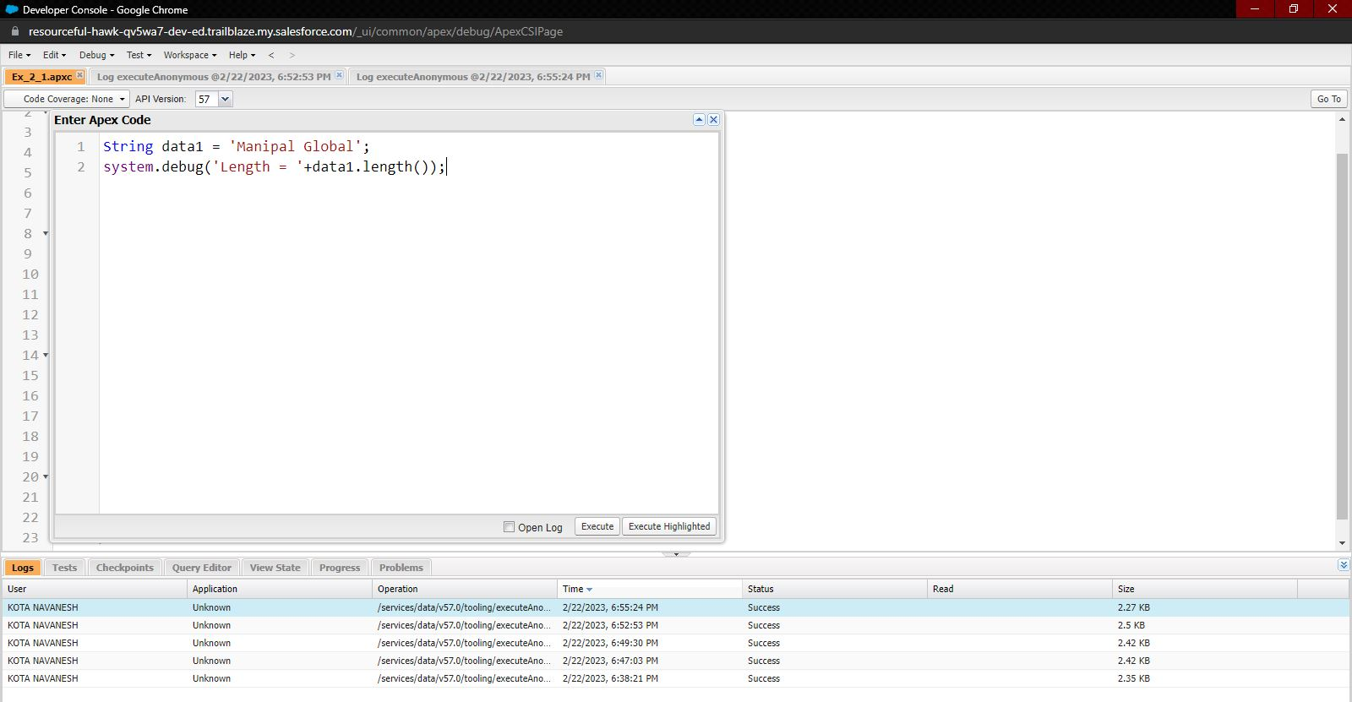
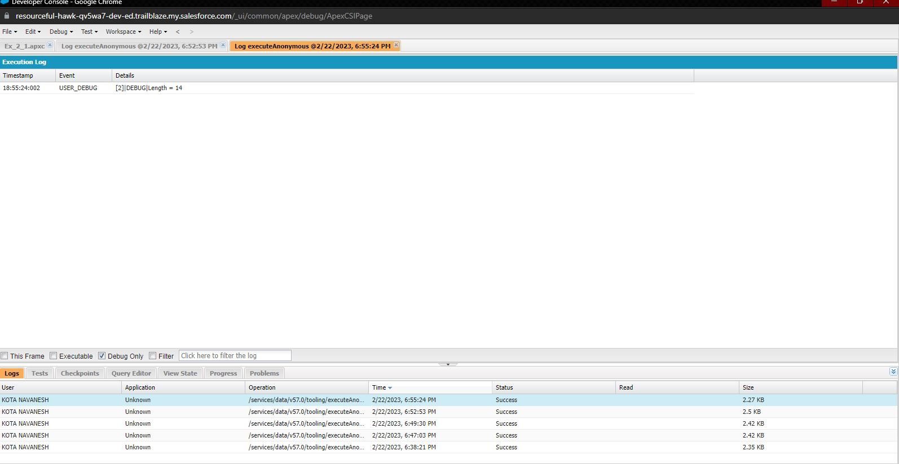
4. Define a String Variable & use string method length() to display the output

Slide 41
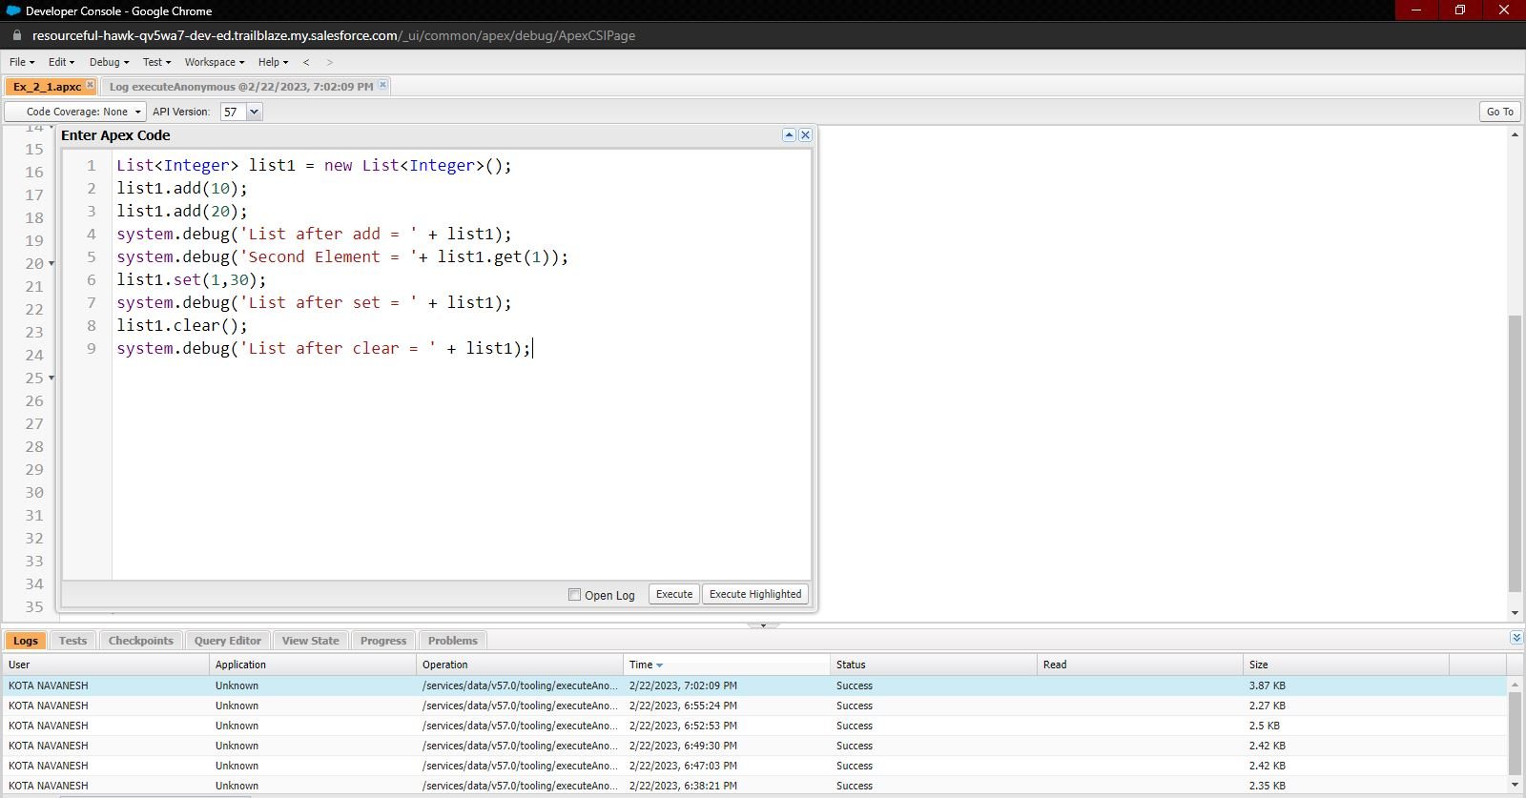
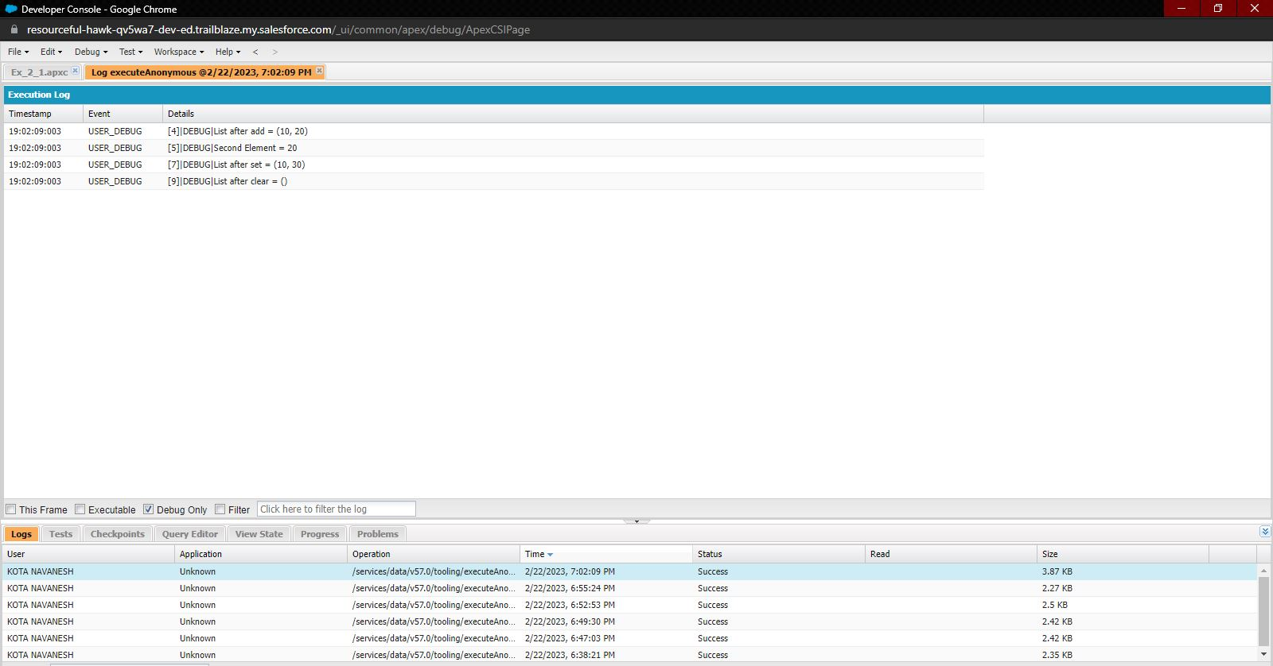
5. Define a List of integer and display the output using add(), get(), set(), clear(), methods.

Slide 42
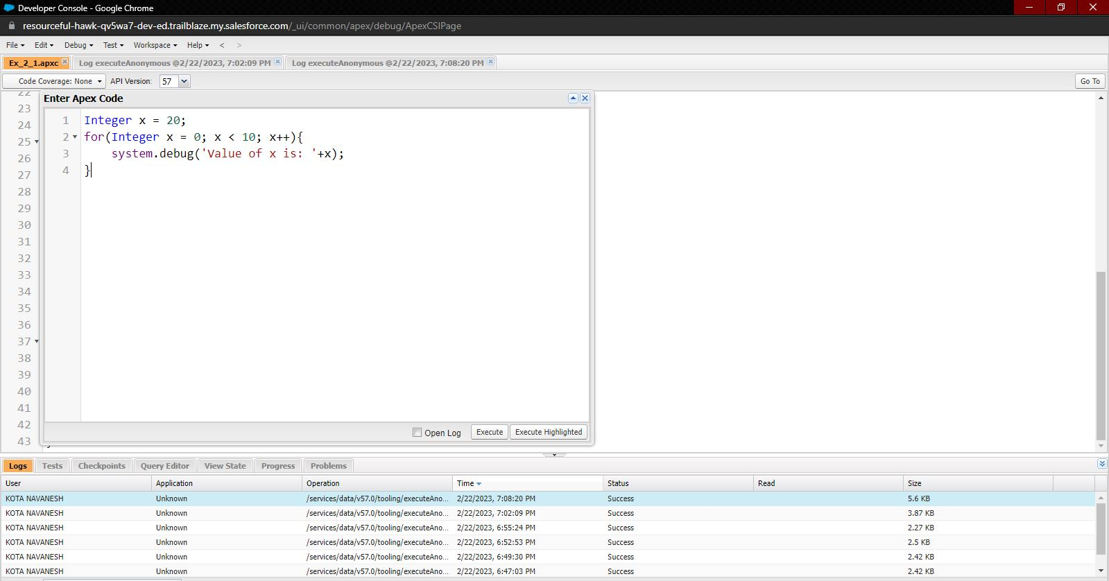
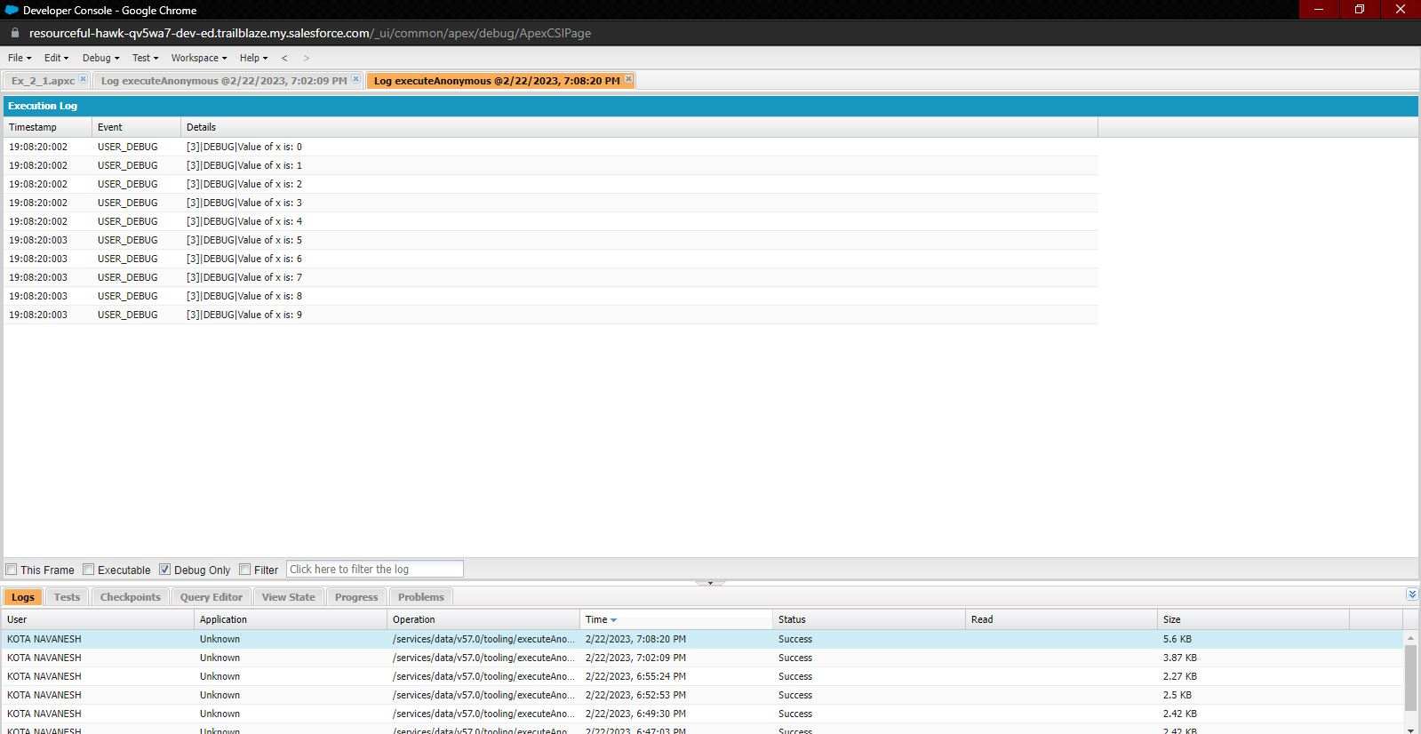
Use Execute Anonymous to define and execute the following code to display the value of x = 0 to 9.

Slide 43
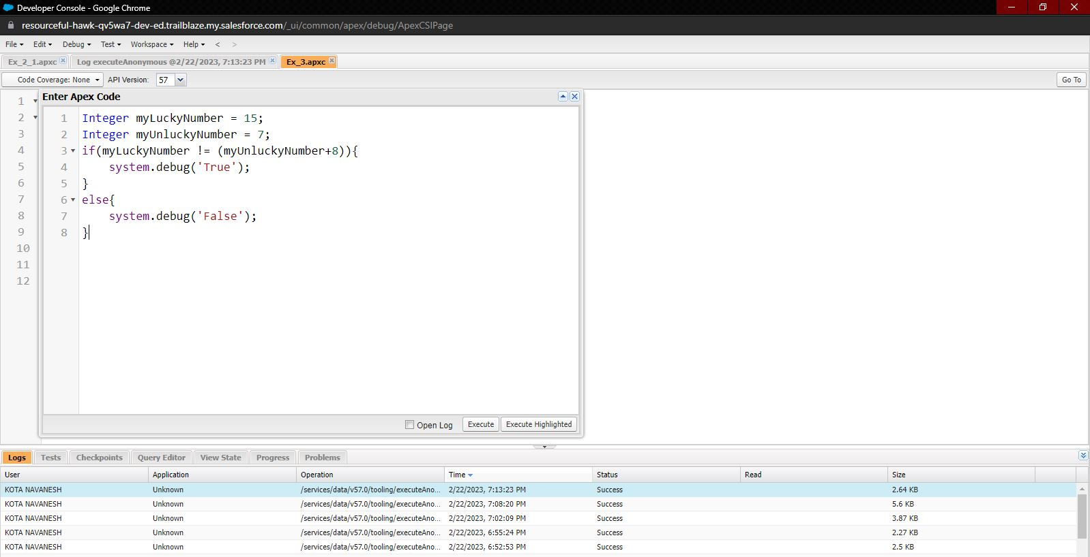
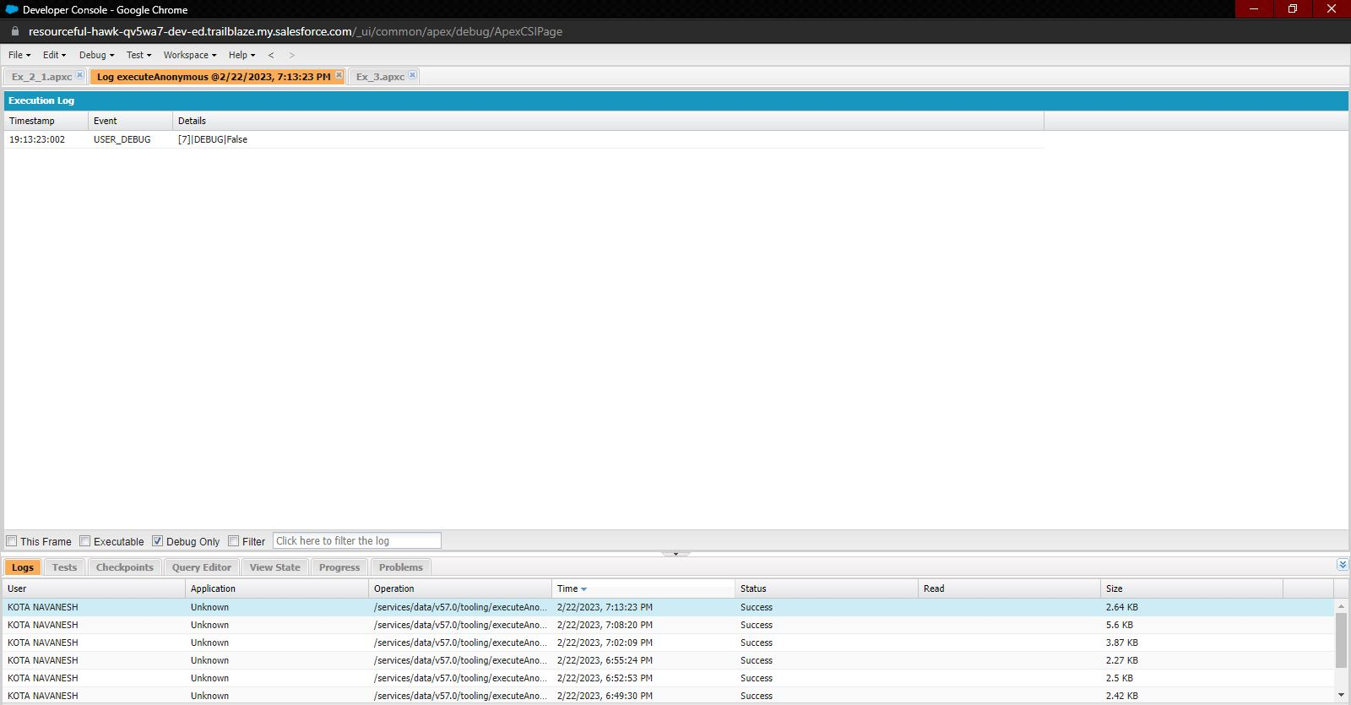
Exercise 3 Answer the following in True or False: Integer myunlucklyNumber = 7; Integer myluckyNumber = 15; myluckyNumber != myunlucklyNumber + 8.

Slide 44
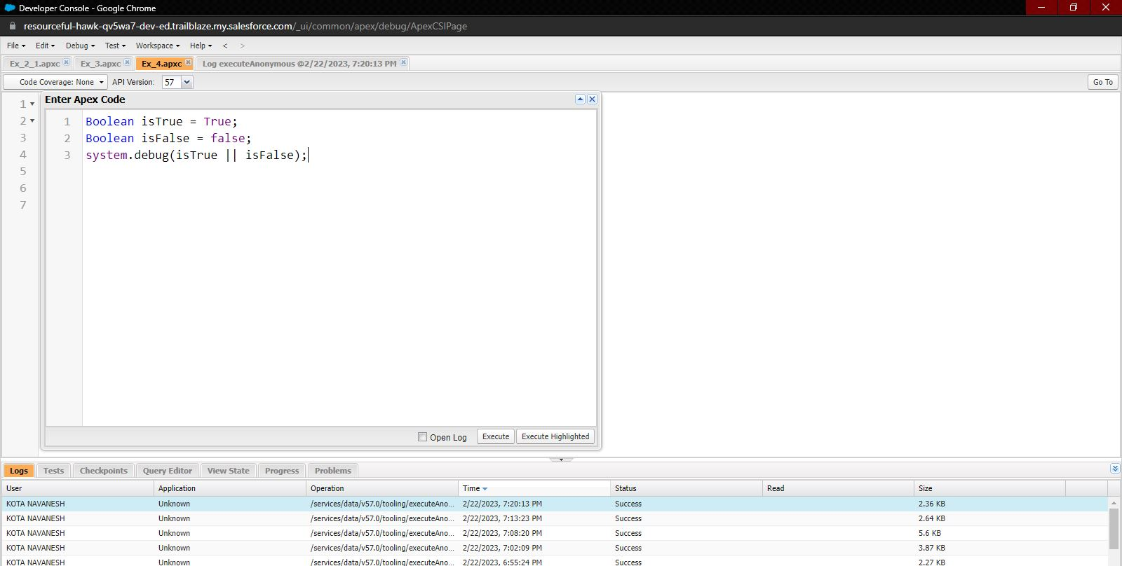
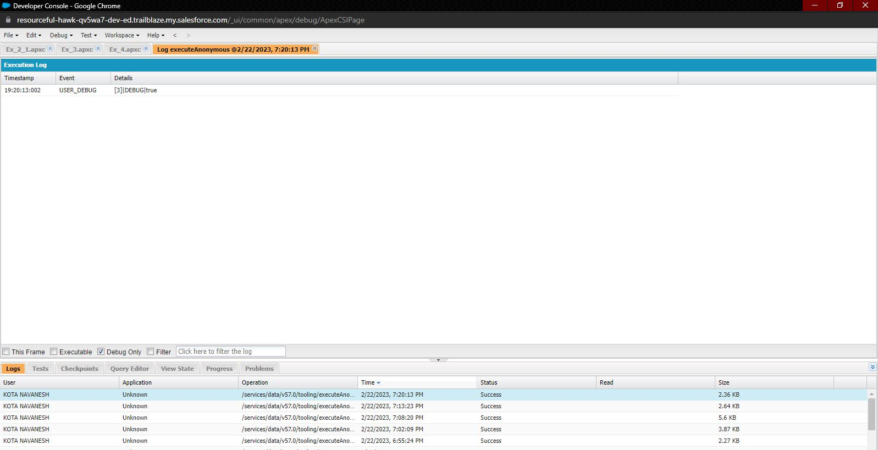
Exercise 4 Answer the following in True Or False: Boolean isFalse = false; Boolean isTrue = true;

Slide 45
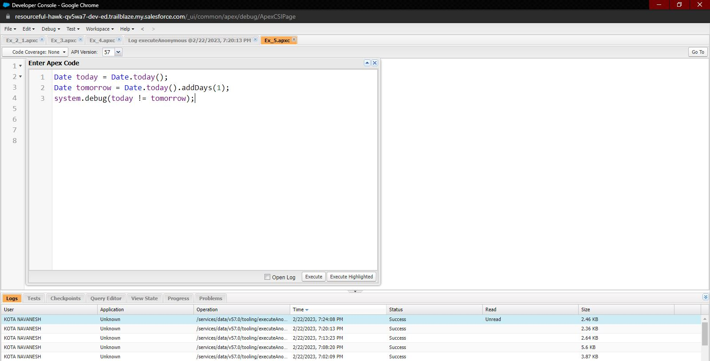
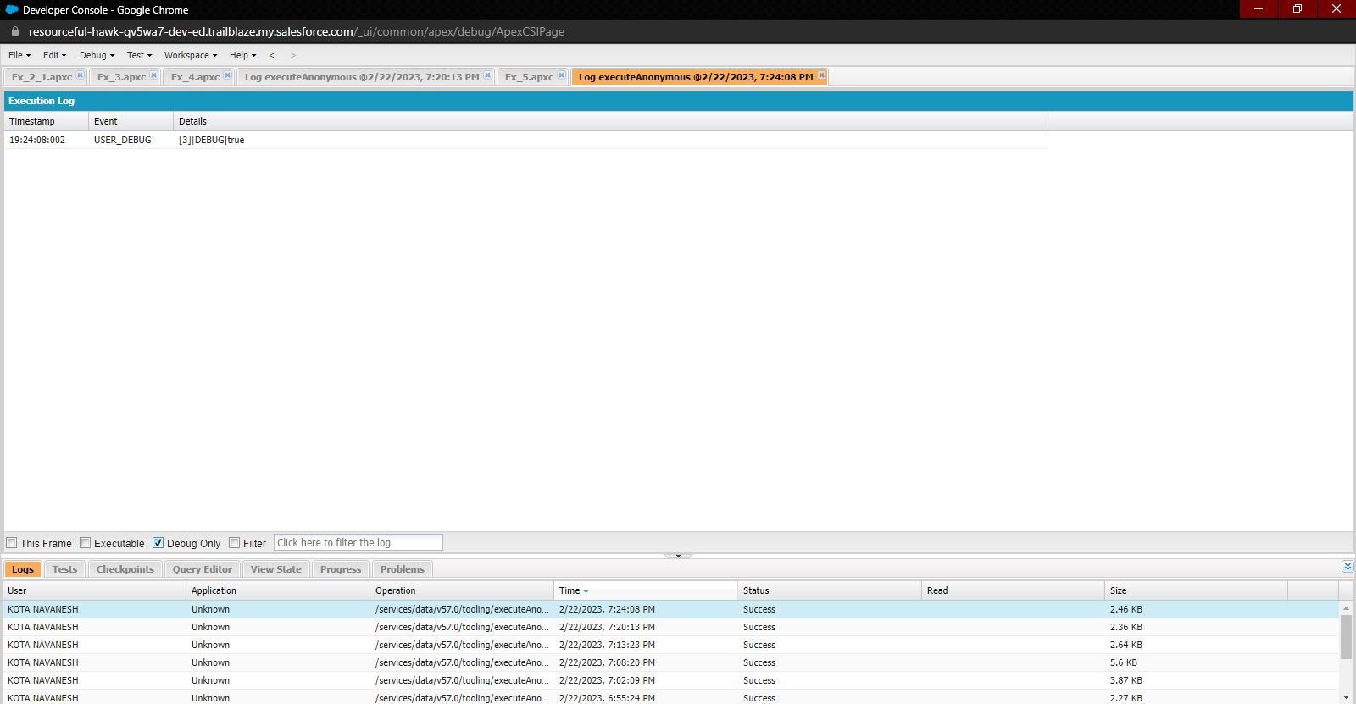
Exercise 5 Answer the following in True Or False: Date tomorrow = Date.today().addDays(1); Date today = Date.today(); today != tomorrow

Slide 46
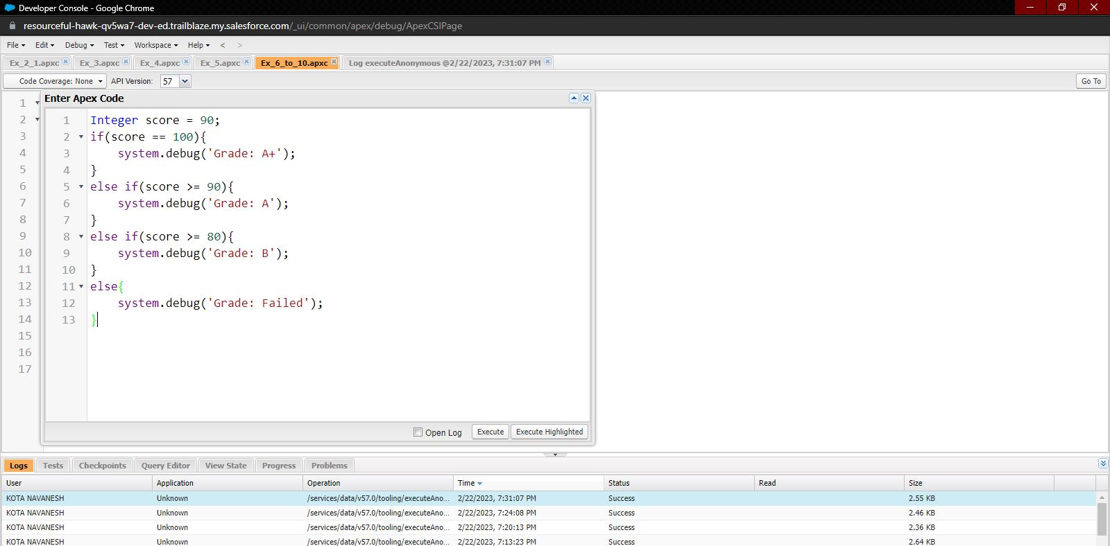
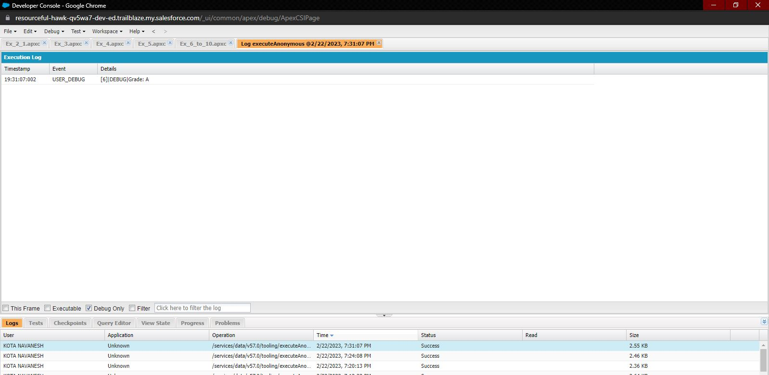
Exercise 6 Write a program and execute to demo the use of “If..else if...else”

Slide 47
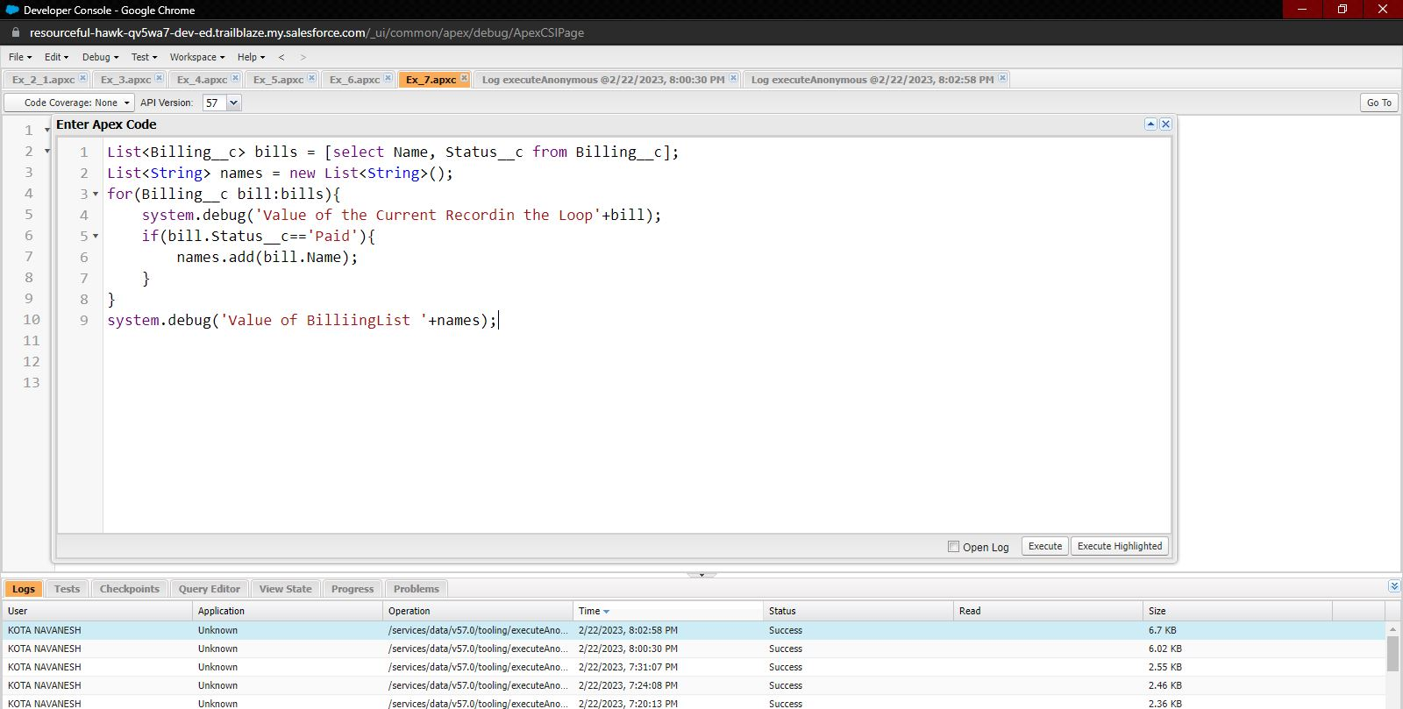
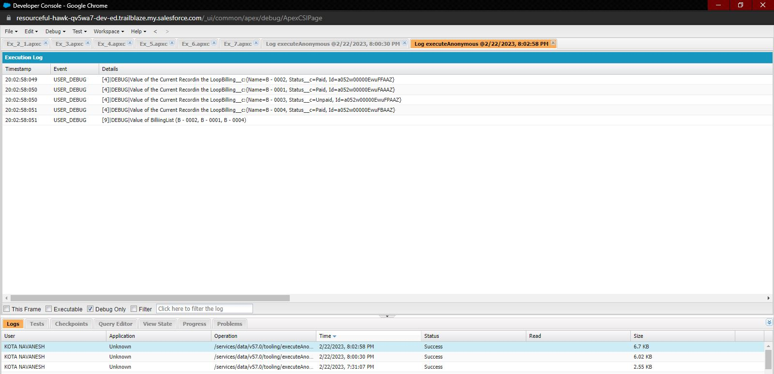
Exercise 7 Write a program to execute and demo the use of “Apex – for Loop”

Slide 48
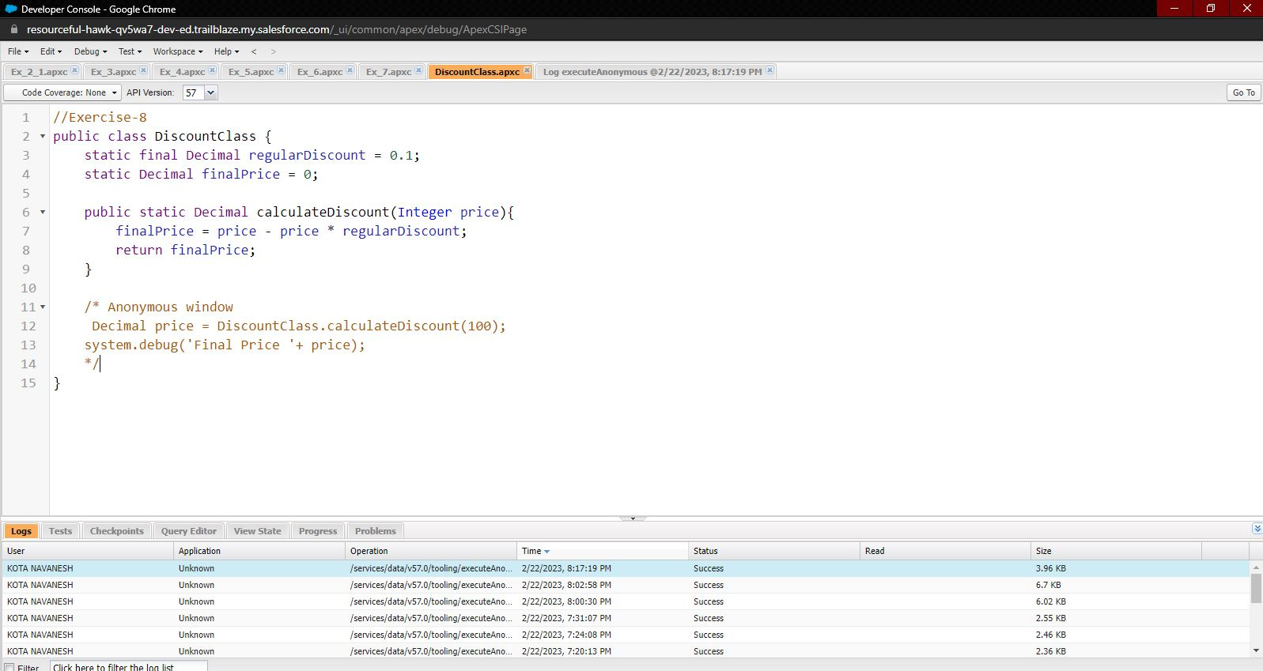

Exercise 8 Write a Class to demo the use of Constants in Apex

Slide 49

Exercise 9 Write a Class to demo the use of Interface in Apex

Slide 50

Exercise 10 Demo on DML Insert Operation Using Database methods 1.Insert a Customer Record First using simple DML Statement

Slide 51


2. Insert Billing record using Database methods Here use record id to insert customer

Slide 52

Exercise 11 Write and execute SOQL queries from Developer Console Display ID, Amount, Stage, Account Name, Account Industry, Account Website From Opportunity AND “Account Annual Revenue > 5000” Add a Where Clause “Account Industry = Energy”

Slide 53

Exercise 12 Write an Apex Trigger, Name = CustomerTrigger. Create a Billing Record when on Customer Object the 'Status' field changes to Active from Inactive. Billing “Status” must be: Paid, Amount Paid = 1000000 Perform the DML on a List.

Slide 54

Exercise 13 Write a Test Class for CustomerTrigger. Create the Data for the Customer custom Object Use Test.startTest() & Test.stopTest(). Use assert statement to validate the output, Test Class must have full code coverage.

Slide 55

Exercise 14 Apex Trigger, Name = DisqualifyTestLeads

Slide 56

Exercise 15 Write a Test Class for DisqualifyTestLeads.

Slide 57


Exercise 16 Create a Visualforce page which displays Opportunity fields as output fields.

Slide 58


Exercise 17 Create a Visualforce page which shows a list of Accounts linked to their record pages

Slide 59



Exercise 18 Create a Visualforce page that uses a custom controller to display a list of cases with the status of 'New'. The page must be named NewCaseList

